Slide 1
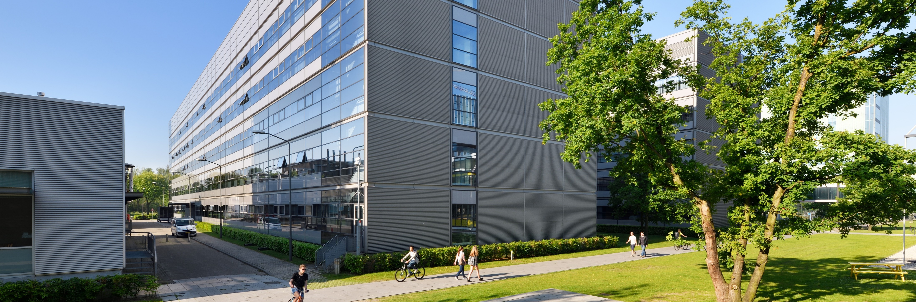
Winter School
Membrane Reactors in Chemical Industry
Eindhoven University of Technology
January 29th-30th, 2024
Membrane-based process design and economic analysis
Rouzbeh Ramezani
Eindhoven University of Technology
Department of Chemical Engineering and Chemistry
Sustainable Process Engineering
r.ramezani@tue.nl

Slide 2

Importance of membrane process design
Membrane process design steps
Single and two-stage membranes
Multi-stage membrane system
Process simulation tools
Economic model
Optimization strategy
Membrane gas separation applications
Agenda

Slide 3
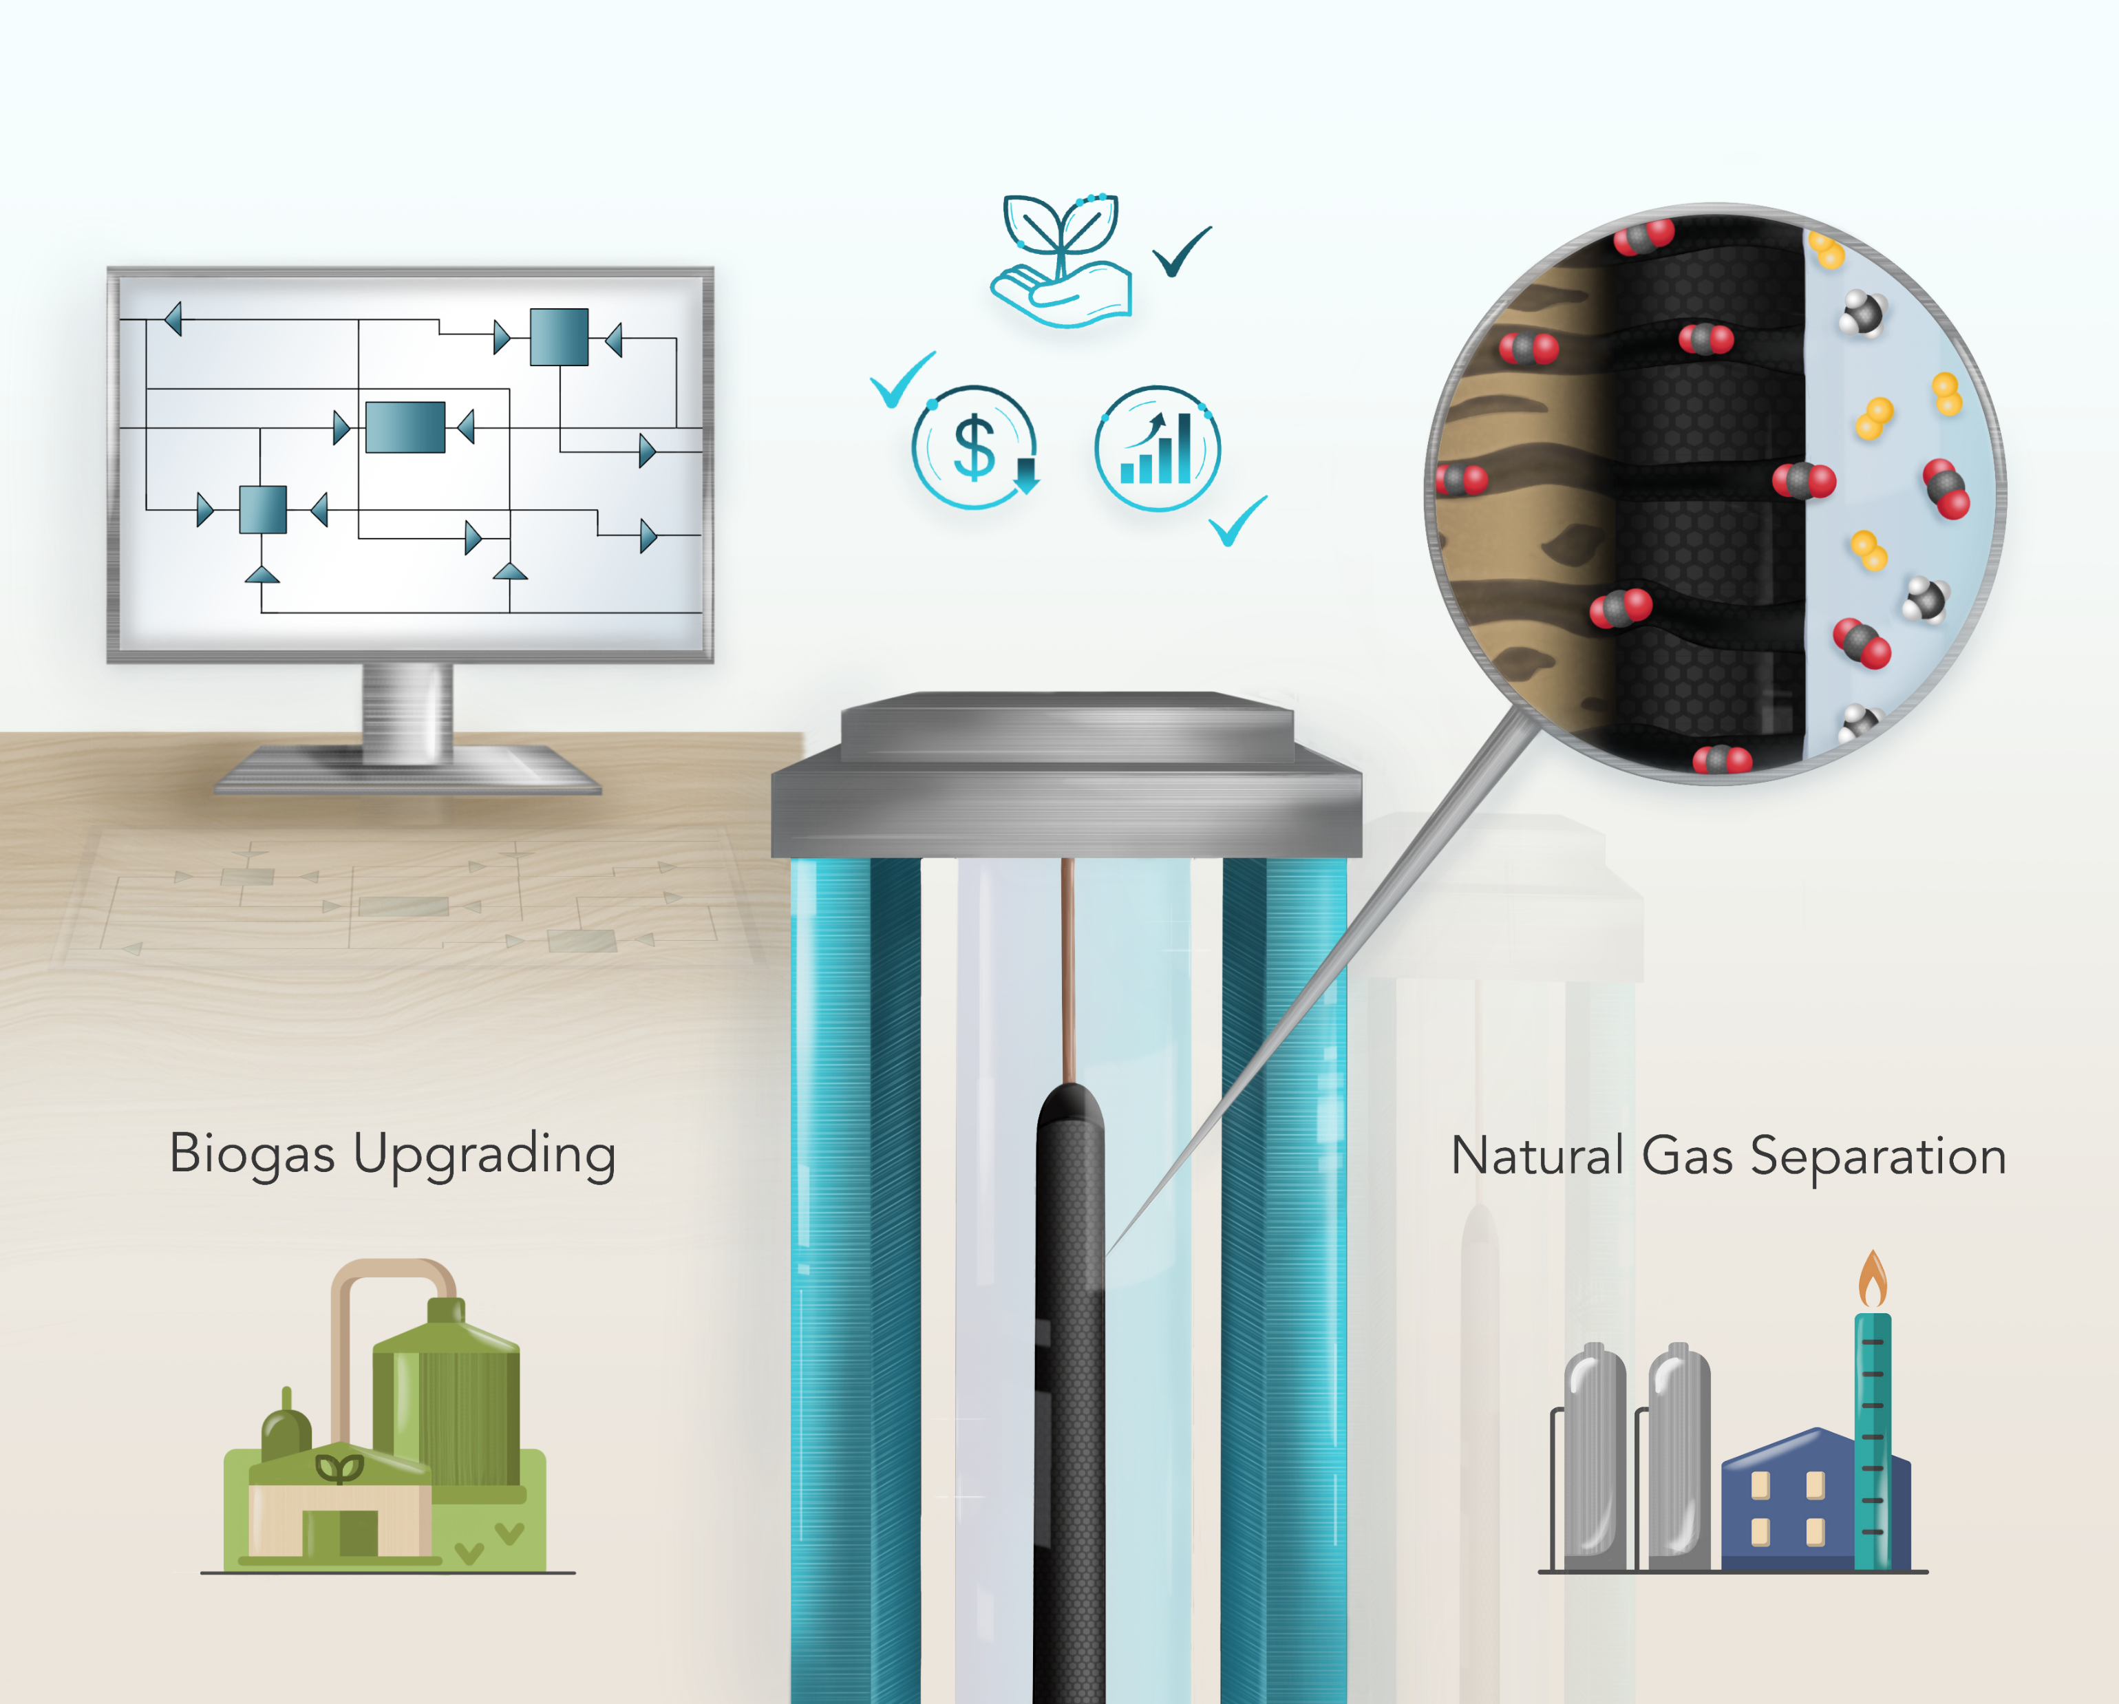
Membrane-based Gas Separation
The potential application of the membrane process in a great measure depends on the capability of membrane materials to provide high separation performance.
Membranes suffer from a trade-off between selectivity and permeability with an upper bound.
An optimal flowsheet of membrane-based gas separation can remarkably decrease capture cost and energy consumption.
The development of efficient and cost-effective multi-stage membrane processes as well as improvements in membrane selectivity and permeance is of major importance.

Slide 4
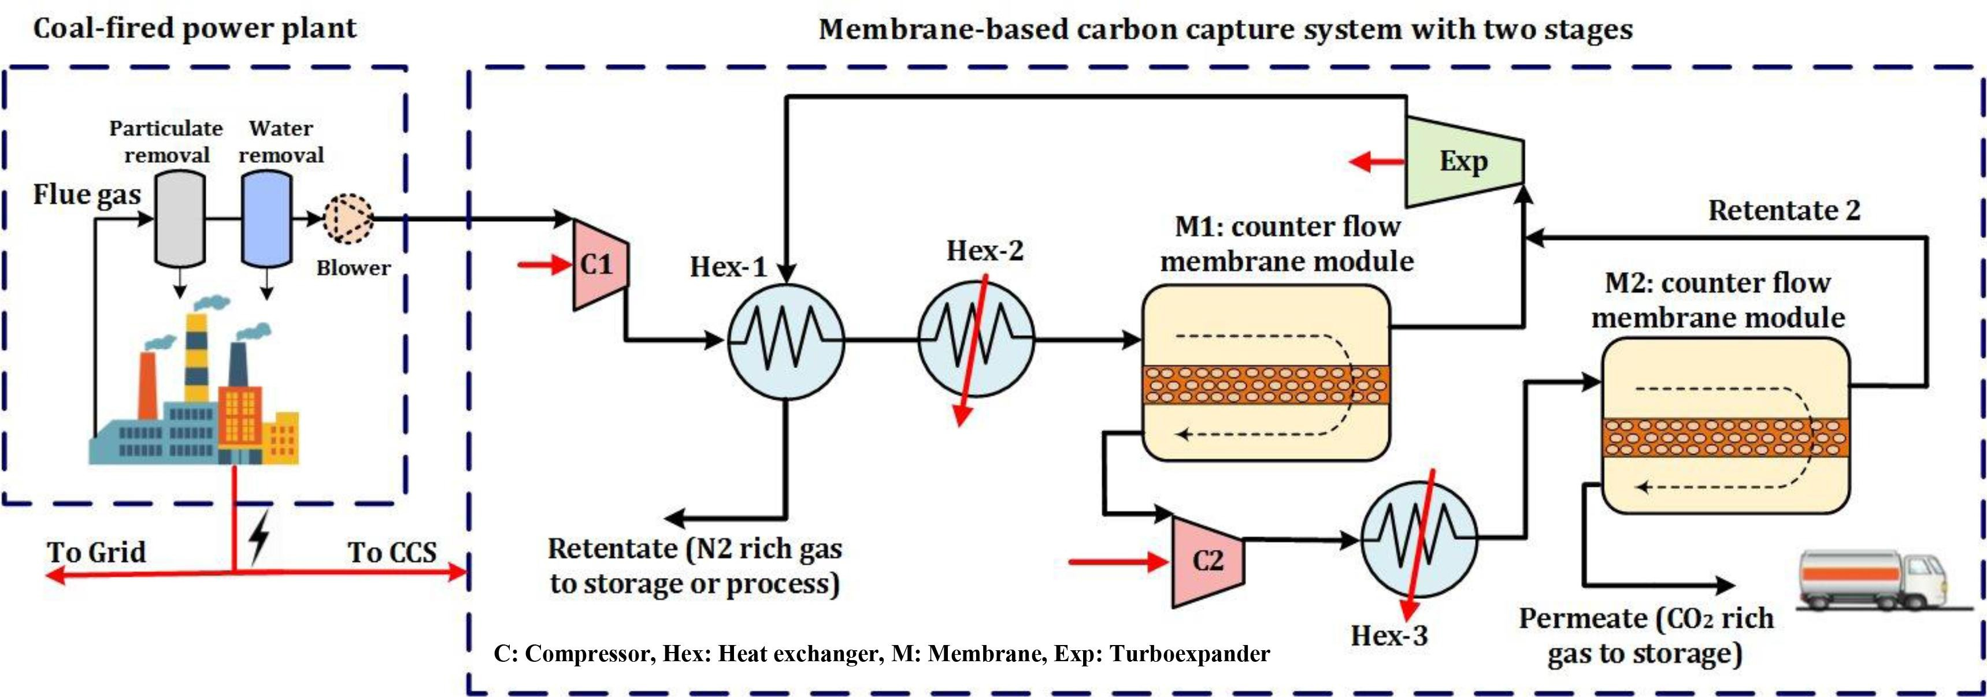
Steps of design of a membrane system
Process design is essential to provide an energy-efficient membrane technology for gas separation.
Feed source and feed conditions
Product quality
Flow configuration
Select number of stages
Membrane type
Optimize the membrane system
*J. Asadi, P. Kazempoor, Energy Conversion and Management, 246 (114633)

Slide 5
Membrane-based process design (single stage)
The selection of the best configuration is highly related to feed quality, separation objectives and market values.
A single-stage membrane process cannot meet high recovery and gas purity at the same time, regardless of the membrane type used.
CO₂/N₂ selectivity must be over 200 to achieve the target separations with CO₂ recovery and purity of >90% and >95%, respectively, in a single-stage membrane configuration.
Since the single-stage membrane process cannot reach the separation goal, a multi-stage membrane system needs to be implemented.
High purity
High recovery

Slide 6
Two-stage cascade for purer retentate or permeate
The first stage performs a bulk separation of for example CO₂ and CH₄
The retentate of the first stage is fed to a second stage in which the final product purity is obtained.
Permeate of the second stage is recycled and mixed with the raw gas stream
The permeate stream of the first membrane, after passing through a compressor, enters the second stage
The permeate stream of the second membrane is considered as the final product

Slide 7
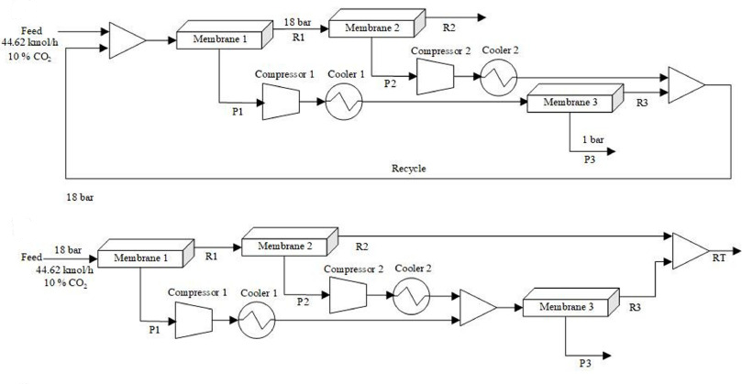
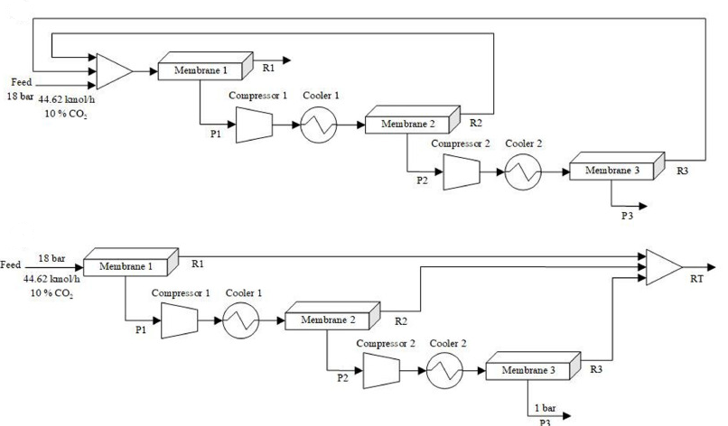
Three-stage membrane module
In most of the literature's examined works, the optimization results were typically derived from heuristic design experience.
Although using this approach does yield an optimum separation system but is in no way viable to assure whether the capture cost is a global optimum.
*M. Samei, A. Raisi, Chemical Engineering and Processing - Process Intensification, 170, 2022, 108676.

Slide 8
Multi-stage membrane module
The selection of the best configuration is highly related to feed quality, separation objectives and market values.

Slide 9
Superstructure membrane module
By applying a structural optimization approach, the most profitable process configuration including stage numbers can be determined.

Slide 10
Superstructure membrane module
By applying a structural optimization approach, the most profitable process configuration including stage numbers can be determined.

Slide 11
Superstructure membrane module
By applying a structural optimization approach, the most profitable process configuration including stage numbers can be determined.

Slide 12
Superstructure membrane module
By applying a structural optimization approach, the most profitable process configuration including stage numbers can be determined.

Slide 13
Flow arrangements in membrane modules
The performance of a membrane is influenced by the way in which the permeate and retentate flow in the membrane.
Flow arrangements of perfect mixing, co-current, counter-current, and cross flow are possible in the design of a membrane module.
Counter-current Flow
Co-current Flow
Cross Flow

Slide 14
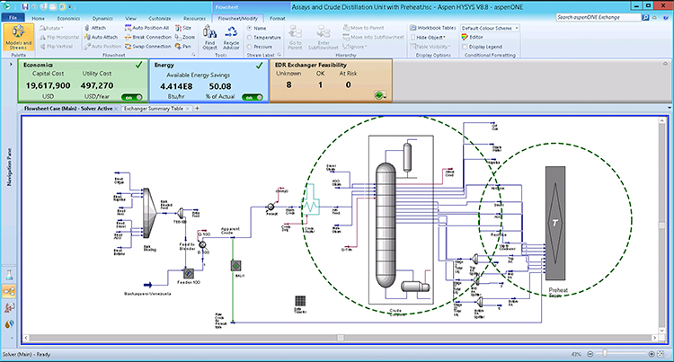
Process Simulation Tools
Process simulators have been proven to be successful in modeling, simulate, and optimize various industrial processes.
Aspen Plus Aspen Hysys | Can be used for batch and continuous processes for design, troubleshooting in regular operations, monitoring the plant performance through online, and real-time optimization.
gPROMS | An advanced equation oriented process modeling software, which can be used to model, analyze, and optimize in an easy-to-use process flow-sheeting environment.
PRO/II | A steady-state simulator which has an in-built membrane unit operation to simulate crossflow symmetric membranes for gas separations.
ProMax | A multifaceted process simulation software which it is designed to optimize gas processing, refining, and chemical facilities.
SuperPro Designer | A flowsheet driven simulator for batch, continuous as well as combination processes, that perform material and energy balances, equipment sizing, and costing.
Aspen Custom Modeler | Provides the capability to create unique process and equipment simulation models by describing the equations which can be exported into Aspen Plus/Hysys.

Slide 15
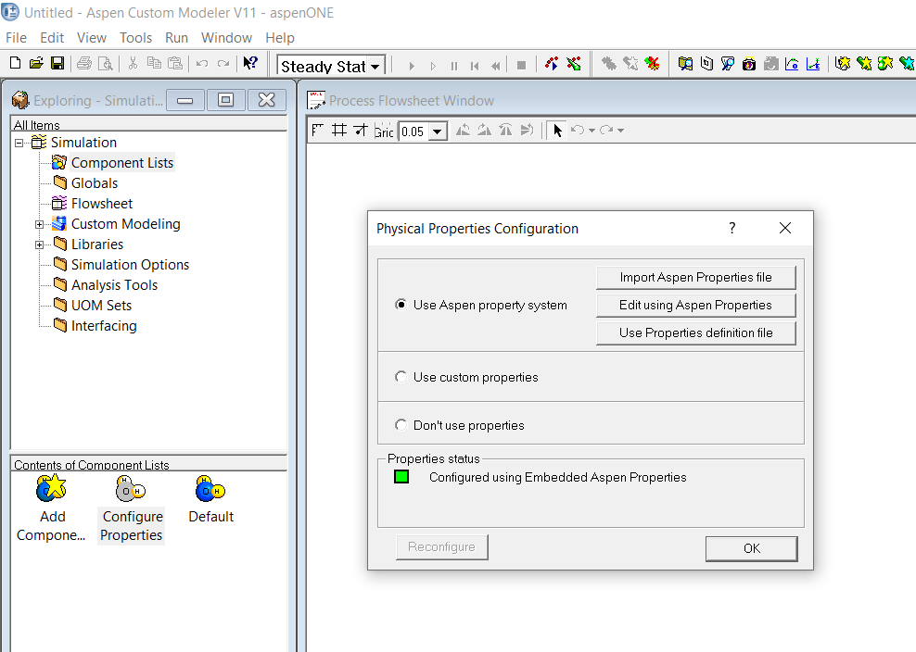
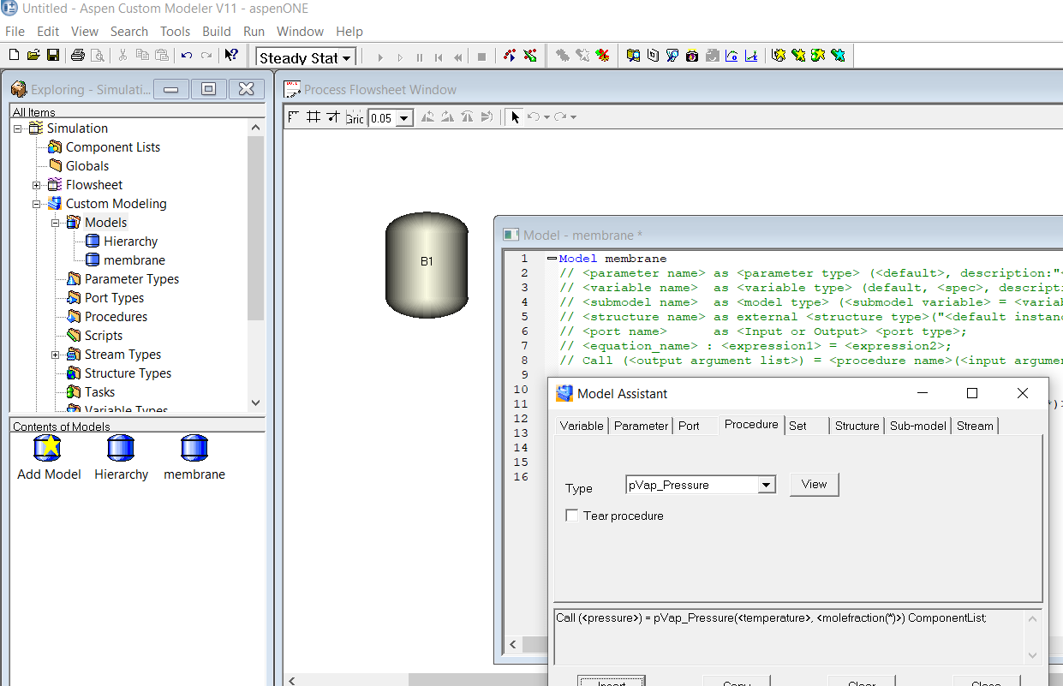
Implementation of Membrane model in Aspen Custom Modeler
The developed mass transfer model for the gas separation membrane process is coded.
The model for membrane gas separation can be implemented and solved in ACM, which can be added to Aspen Plus.
To implement the membrane model in ACM, all chemicals are defined from the component list in the Aspen Properties User Interface program.
Fixed variables or inputs (feed temperature, pressure, composition and membrane area) are defined, and the process parameters (for example, permeance) and variables are declared.
The model has one port for feed stream and two ports as permeate and retentate streams.

Slide 16
Implementation of Membrane model in Aspen Custom Modeler

Slide 17

Economic model
To find the best configuration of the multi-stage gas membrane process, the cost analysis was conducted for:
Post-combustion (CO₂/N₂)
Natural gas sweetening (CO₂/CH₄)
Biogas upgrading (CO₂/CH₄)
H₂ separation (H₂/CH₄)
The aim is to minimize the cost of separation while satisfying the separation targets.
The economic analysis of the superstructure membrane process was performed by calculating the capital cost, annual operating and maintenance, and energy cost.
Capital cost is associated with membrane area and membrane module skids as well as the contribution of major components such as compression, expander and vacuum pumps.
Operational cost is a sum of electricity cost, and operation and maintenance costs. Operation and maintenance of the vacuum pumps, expander and compressors is estimated at 3.6% of their capital cost and 1% for the membrane and the membrane frame.

Slide 18
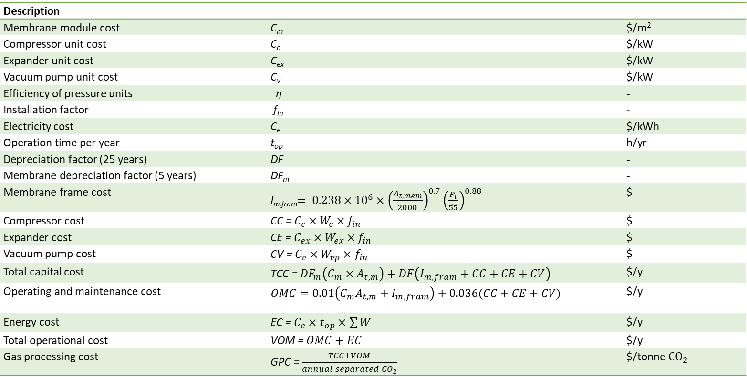
Economic model
Description
Membrane module cost | C_{m} | $/m²
Compressor unit cost | C_{c} | $/kW
Expander unit cost | C_{ex} | $/kW
Vacuum pump unit cost | C_{v} | $/kW
Efficiency of pressure units | η | -
Installation factor | f_{in} | -
Electricity cost | C_{e} | $/kWh⁻¹
Operation time per year | t_{op} | h/yr
Depreciation factor (25 years) | DF | -
Membrane depreciation factor (5 years) | DF_{m} | -
Membrane frame cost | I_{m,fram}$= 0.238×{10}^{6}×{\left(\frac{A_{t,mem}}{2000}\right)}^{0.7}{\left(\frac{P_{t}}{55}\right)}^{0.88}$ | $
Compressor cost | CC = $C_{c}×W_{c}×f_{in}$ | $
Expander cost | CE = $C_{ex}×W_{ex}×f_{in}$ | $
Vacuum pump cost | CV = $C_{v}×W_{vp}×f_{in}$ | $
Total capital cost | TCC = ${DF}_{m}\left(C_{m}×A_{t,m}\right)+DF\left(I_{m,fram}+CC+CE+CV\right)$ | $/y
Operating and maintenance cost | $$OMC=0.01\left(C_{m}A_{t,m}+I_{m,fram}\right)+0.036(CC+CE+CV)$$ | $/y
Energy cost | EC = $C_{e}×t_{op}×\sum{W}$ | $/y
Total operational cost | VOM = $OMC+EC$ | $/y
Gas processing cost | GPC = $\frac{TCC+VOM}{annual separated {CO}_{2}}$ | $/tonne ${CO}_{2}$

Slide 19
Optimization strategy
Input variables: Feed conditions, Membrane selectivity and gas permeance, target pressure, product specification
Targets: CO₂ or CH₄ recovery and purity, minimum GPC
Decision variables: Membrane area of each stage, retentate pressure, permeate pressure of each stage, split fractions
Output variables: Compressor power, membrane area, CAPEX, OPEX, GPC, number of stages

Slide 20
1. Post-combustion CO₂ capture
Post-combustion CO₂ capture should meet conditions of low energy consumption, small footprint, high CO₂ purity (≥ 90%) and recovery (≥ 90%), no adverse environmental impact, and minimal gas processing costs.
Feed characteristic
Feed flow rate | 2000 kmol/hr
Feed temperature | 313.15 K
Feed pressure | 1 bar
Feed composition | 14 % CO₂ 86 % N₂
CO₂ emission | 505 tons/hr
Output targets
CO₂ recovery | 90 % and 98 %
CO₂ purity | 95 % and 98 %
Product pressure | 76 bar
The flue gas produced from coal combustion has low CO₂ composition and a high-volume flow rate. For example, a 500 MW coal-fired power plant emits approximately 426 tons of CO₂ per hour

Slide 21
1. Post-combustion CO₂ capture
CO₂/N₂ selectivity=170
CO₂ purity= 95 %
CO₂ recovery=90 %

Slide 22
1. Post-combustion CO₂ capture
CO₂/N₂ selectivity=170
CO₂ purity= 95 %
CO₂ recovery=90 %
Area= 25167 m²
GPC= 41.8 €/tonCO₂
SEC= 1.90 GJ/tonCO₂

Slide 23
1. Post-combustion CO₂ capture
CO₂/N₂ selectivity=170
CO₂ purity= 95 %
CO₂ recovery=90 %
Area= 25167 m²
GPC= 41.8 €/tonCO₂
SEC= 1.90 GJ/tonCO₂

Slide 24
1. Post-combustion CO₂ capture
The separation costs vary from 41.8 €/ton_{CO2} to 52 €/ton_{CO2} avoided depending on the recovery purity constraints imposed, indicating separation target has a significant effect on capture cost.

Slide 25
1. Post-combustion CO₂ capture
The contribution of capital cost and operating cost to the total annual cost show how the main items affect the final capture cost.
For every product target, OPEX presents the highest contribution to the annual cost.

Slide 26
1. Post-combustion CO₂ capture
Cost of membrane (CM), compressor (CC), expander (CE) and vacuum pump (CV)

Slide 27
2. Natural gas separation
Every year, the world uses close to 3.9 trillion cubic meters of natural gas.
CO₂ separation from natural gas is critical as the presence of CO₂ adversely affects the produced gas quality, and can form acids in the presence of water that corrodes the pipelines and equipment.
CO₂ content in natural gas needs to be decreased to below 3%.
Feed gas characteristic | Feed flow rate | 1700 kmol/hr
 | Feed temperature | 298.15 K
 | Feed pressure | 20 bar
 | Feed composition | 10 % CO₂ 90 % CH₄
Output targets | CH₄ recovery | 99 %
 | CH₄ purity | 97.5 %
 | Product pressure | 35 bar

Slide 28
2. Natural gas separation

Slide 29
2. Natural gas separation

Slide 30
2. Natural gas separation (polymeric membrane)

Slide 31
3. Biogas Upgrading
Biogas is a potential alternative to the world’s unquenchable demand for energy and concurrently reduces waste and greenhouse gas emissions.
CO₂ is the non-combustible portion of biogas.
CO₂ has to be removed from CH₄ to enhance the heating value of the product gas.
CH₄ mole fraction in the raw gas of 60% has to be increased to more than 90% in order to meet the natural gas grid requirements.
CH₄ purity and recovery are the most important technical parameters in determining an optimal module arrangement to ensure a low CH₄ loss.
Feed gas characteristic | Feed flow rate | 44.6
 | Feed temperature | 298.15 K
 | Feed pressure | 1 bar
 | Feed composition | 40 % CO₂ 60 % CH₄
Output targets | CH₄ recovery | 98 %
 | CH₄ purity | 95 %
 | Product pressure | 35 bar

Slide 32
3. Biogas Upgrading

Slide 33
Conclusion
The proposed superstructure is beneficial for further reduction of the cost associated with membrane CO₂ capture process and can be successfully applied for various applications.
The membrane selectivity plays a key role on final gas separation cost.
Three-stage structure with two recycle streams and two vacuum pumps is the most profitable layout for post-combustion CO₂ capture.
The gas separation costs increased from about 41 to 52 €/ton CO₂, when product targets increased from 90% recovery and 95% purity to 95% recovery and 98% purity.
A two-stage process with one recycle stream is able of upgrading biogas to meet the separation targets of 98% recovery and 98% CH₄ purity.

Slide 34
Thank you

