Slide 1
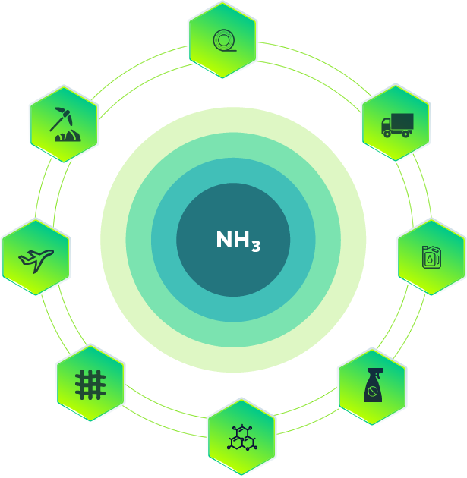




Catalysis for
Ammonia Energy
Dr. Antonio Vita
WINTER SCHOOL
Membrane Reactors in Chemical Industry
Fuel Processing Materials and Technologies
January 29th and 30th, 2024
TU/e Eindhoven
antoniosalvatore.vita@cnr.it , antonio.vita@itae.cnr.it (Head of FPMaT)
Institute for Advanced Energy Technologies (ITAE),
Via Salita S. Lucia sopra Contesse n. 5, 98126 S. Lucia, Messina, Italy

Slide 2
TABLE OF CONTENTS
7
Iron Catalysts
1
What is Ammonia?
The heart of large-scale ammonia plant, Early Development of Iron-Based Catalysts, Promoted Iron Catalysts...
Ammonia structure and properties
2
Conventional uses of Ammonia
7
Ru –based Catalysts
Fertilizer industry, production of nitrogen-containing chemicals, Textile industry….
Supported Ru Catalysts, Electride-Based Catalysts…
3
Major Manufacturers & Infrastructure
8
Co –based Catalysts
Global ammonia production, Principal infrastructures
Cobalt catalysts doped with cerium and barium...
4
Ammonia production on a large scale
8
Metal nitride Catalysts
The Haber-Bosch process and its role
5
The decarbonisation of ammonia production
Ternary nitrides...
Blue and Green ammonia production for long-term H₂ storage and energy applications
9
AMBHER Project Catalysts
6
For integration with ammonia selective membrane
Ammonia synthesis: Thermodynamic equilibrium
Temperature & pressure

Slide 3
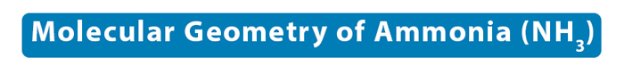
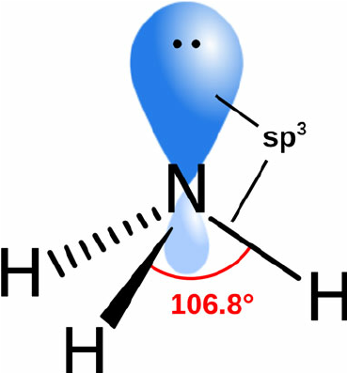





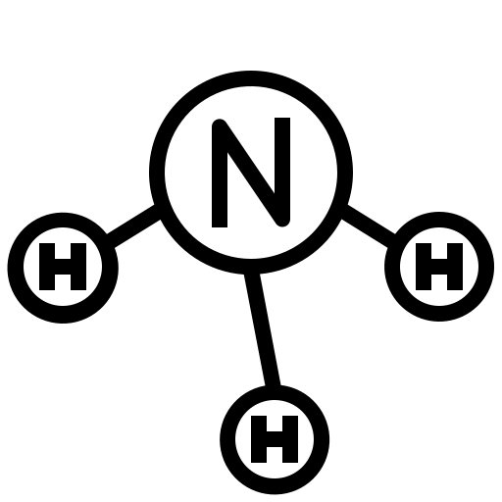

What is Ammonia?
1
Trigonal Pyramidal
Ammonia is a colourless gas with a strong, pungent odour
The difference between the electronegativities of nitrogen (3.04) and hydrogen (2.18) is relatively high (0.86), making the N-H bond highly polar
1.1020Å
The N-H bond energy is equal to 391 KJ/Mol
The density of ammonia is lighter than air, which is 0.73 kg/m³
Overall, ammonia has three N-H covalent bonds and one lone pair of electrons on nitrogen
The electron geometry of ammonia is tetrahedral. Due to the lone pair, its molecular geometry is a distorted tetrahedral.
According to VSEPR theory, the lone pair will exert a repulsive force on the bond pair.
The N-H bonds will bend toward each other and away from the lone pair. Ammonia will acquire a trigonal pyramidal shape with a bond angle of 107°.
This angle is less than the ideal tetrahedral bond angle of 109°.
It has a boiling point of -33.34 °C (higher than N₂ and H₂) and melting point of -77.73 °C
It has a high hydrogen content (17.6 wt%)
Ammonia: 121 kg H₂/m³ , Methanol: 99 kg H₂/m³ , Liquid Hydrogen: 71 kg H₂/m³ , LOHC: 57 kg H₂/m³
It can liquefy at 0.86 MPa at 25 °C, resulting in a high volumetric energy density of 10.5 MJ L⁻¹, which is twice that of compressed hydrogen at 70 MPa (5 MJ L⁻¹)

Slide 4
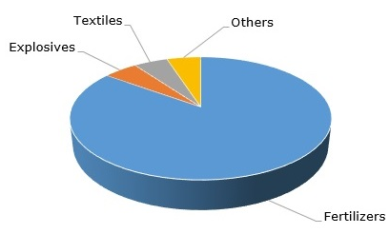
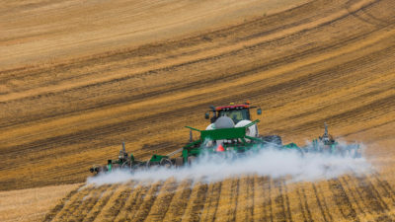
2
CONVENTIONAL USES OF AMMONIA
Major ammonia uses
Fertilizer industry
“Today, roughly 80% of the annually produced ammonia is used for fertilizer production”
Textile industry
“Liquid ammonia has found wide application in the tanning industry, as well as in the production of dyes used in textile colouring”
Explosive industry
“Weapons manufacturers use a very large amount of ammonia. Primarily for the production of explosives. It is a flammable compound that ignites spontaneously at temperatures above 630°C.”
Cosmetic industry
“Used at a specific concentration, is considered a completely safe substance, therefore, it is very widely used in the production of hair dyes.”

Slide 5
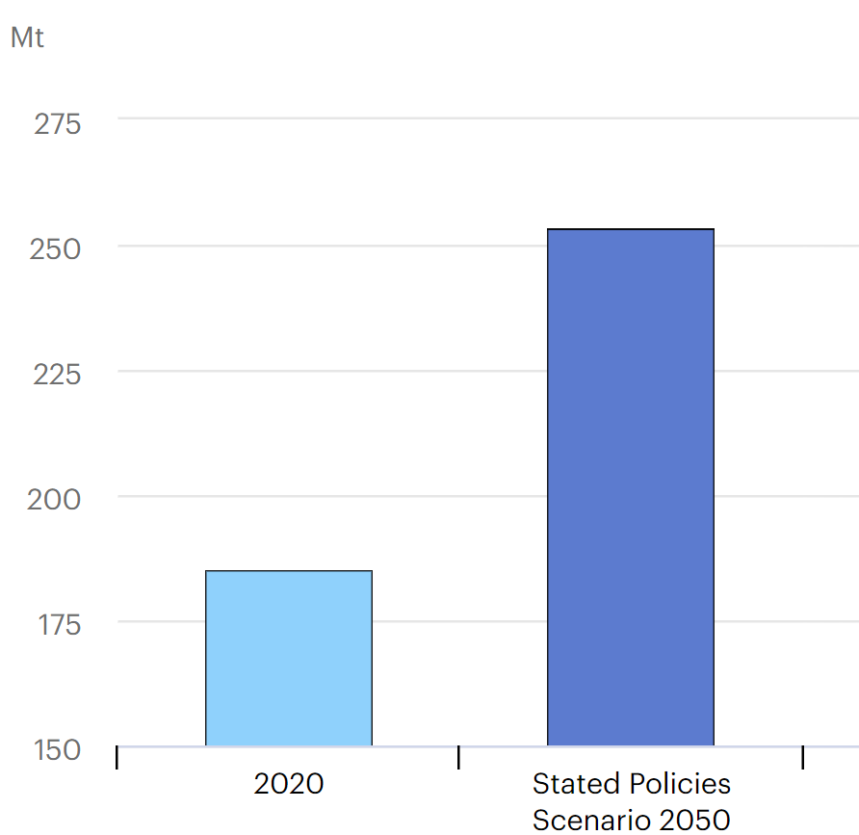
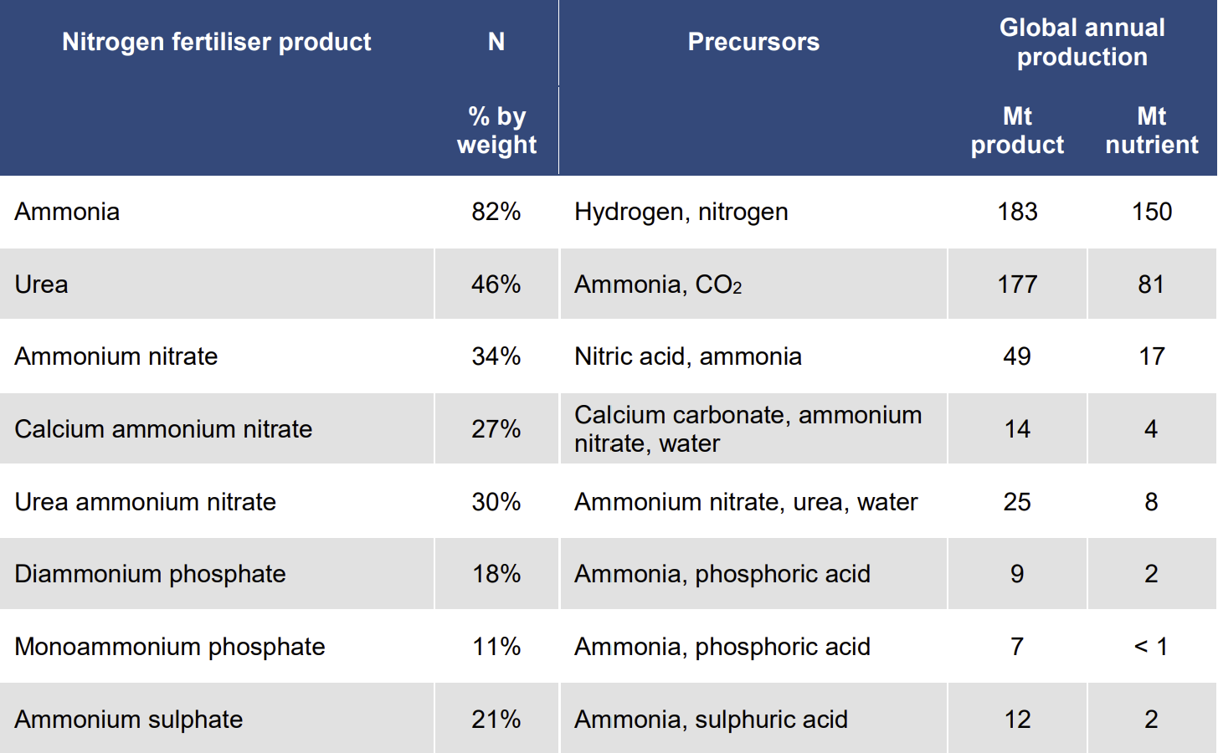
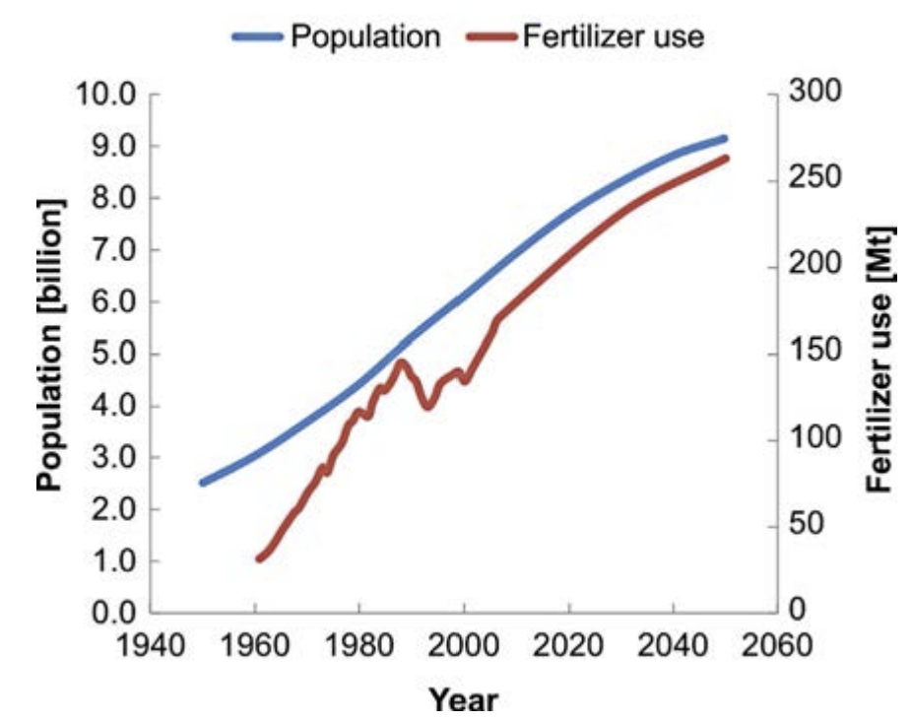
2
CONVENTIONAL USES OF AMMONIA
Change in ammonia demand, 2020-2050
Fertilizer industry - Ammonia in agriculture: The engine of plant growth
“Today, roughly 80% of the annually produced ammonia is used for fertilizer production”
Fertilization improves plant nutrition, promotes plant growth, improves crop quality, and ultimately maintains and even enhances soil fertility;
Crops may require about 20-350 kilograms of nutrients per hectare over the course of their development;
In the Stated Policies Scenario, ammonia production increases by nearly 40% by 2050, driven by economic and population growth;
Urea, its most common derivative, is traded even more widely, at just under 30% of its production.
IEA, Change in ammonia demand between scenarios, 2020-2050, IEA, Paris https://www.iea.org/data-and-statistics/charts/change-in-ammonia-demand-between-scenarios-2020-2050, IEA. Licence: CC BY 4.0
Key nitrogen fertilisers and their characteristics
World population and fertilizer consumption,
with projections to 2050

Slide 6
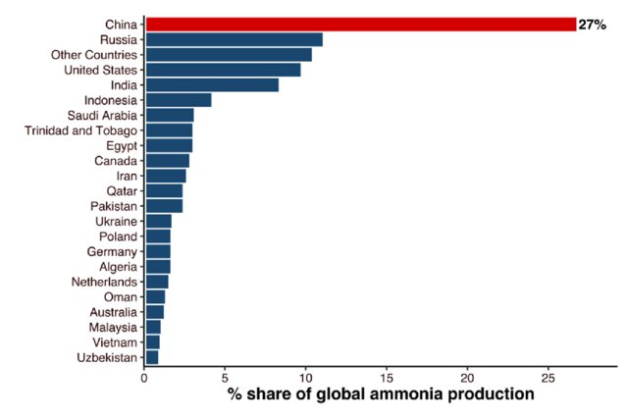
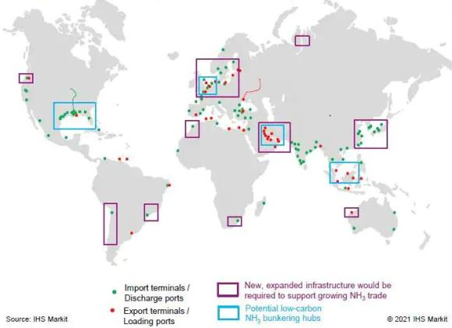
3
MAJOR MANUFACTURERS & INFRASTRUCTURE
Global ammonia production
“China is the largest producer of ammonia”
China is the largest producer of ammonia, accounting for 27% of production, with the United States, the European Union, India, Russia and the Middle East accounting for a further 8-10% each;
Country breakdown of global ammonia production, 2021
Principal infrastructures
“Well-established international existing infrastructure for ammonia transportation and storage”
There is a comprehensive network of harbours around the world that handle ammonia on a large scale;
There are special ammonia terminals at 38 ports that export ammonia and 88 ports that import ammonia, including six ports that export and import ammonia;
Many terminals are parts of ammonia/fertilizer plants located on the coast or riverbanks;
There are numerous ports in the Middle East, South Asia, the Baltic Sea, Northwest Europe, the Mediterranean, the Caribbean Basin, North America, Asia, Oceania, South America, and South Africa
Global Ammonia Infrastructure: Marine Terminals

Slide 7
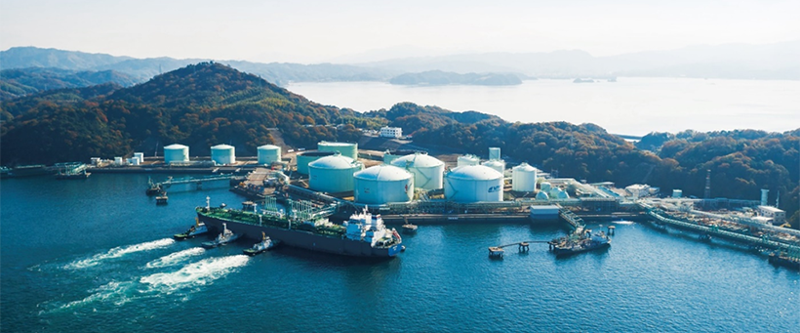
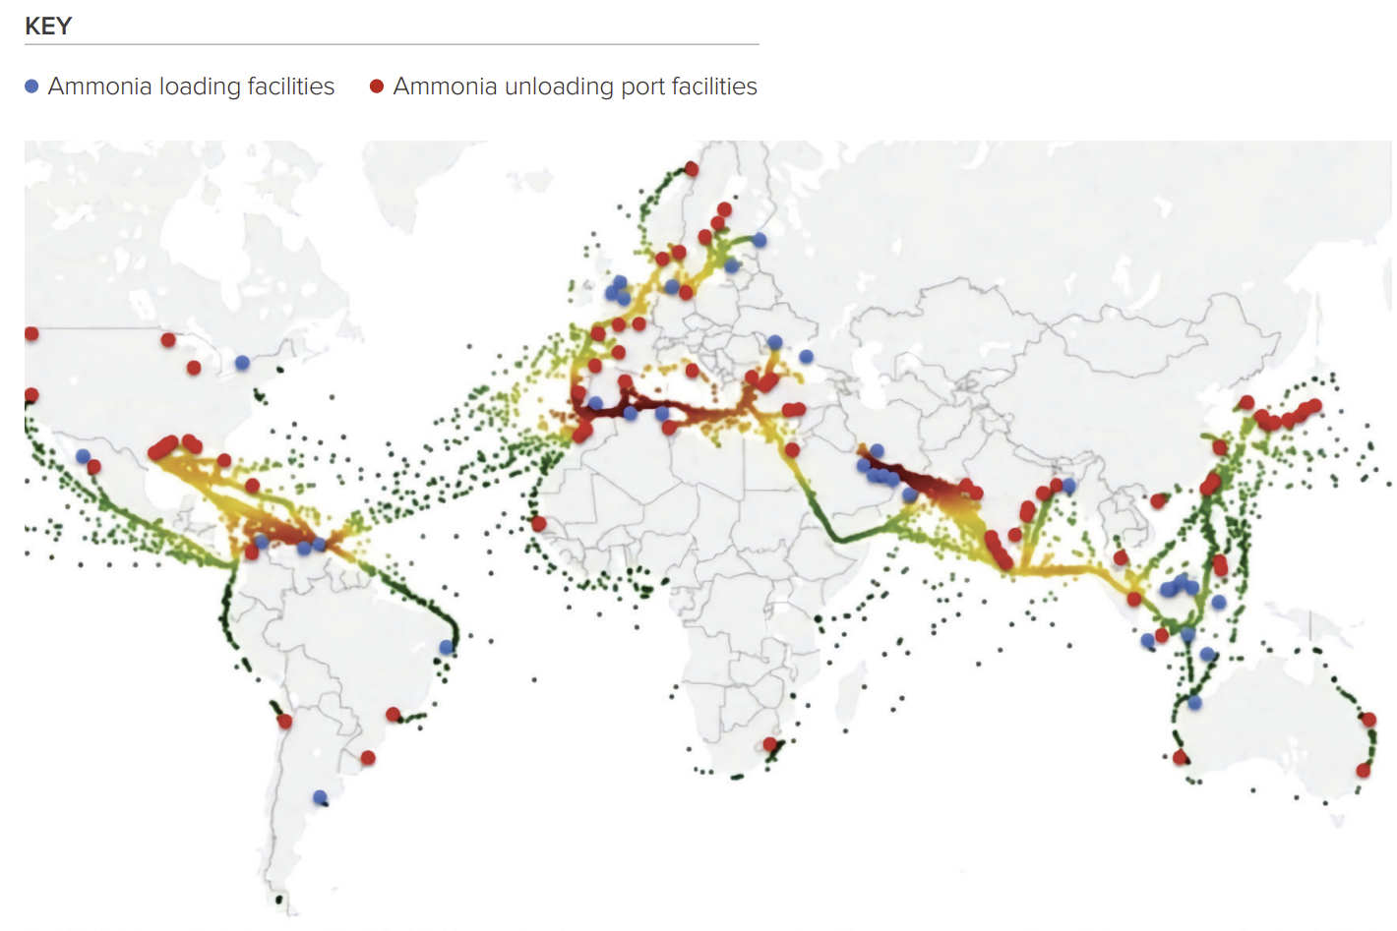
3
MAJOR MANUFACTURERS & INFRASTRUCTURE
Principal infrastructures
“Well-established international existing infrastructure for ammonia transportation and storage”
Country breakdown of global ammonia production, 2021
Ammonia shipping infrastructure, including a heat map of liquid ammonia carriers and existing ammonia port facilities. (Royal Society Ammonia: zero-carbon fertiliser, fuel and energy store2020).
Namikata Terminal (Japan): The existing LPG tanks owned by Mitsubishi Cooperation at the terminal will be converted to ammonia tanks and the terminal will become a hub handling approximately 1 million tonnes of ammonia per year by 2030.

Slide 8
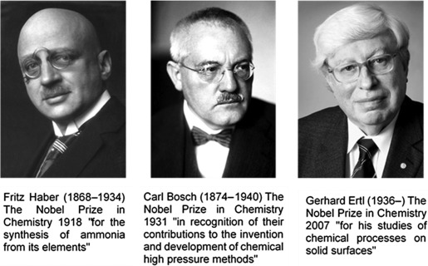
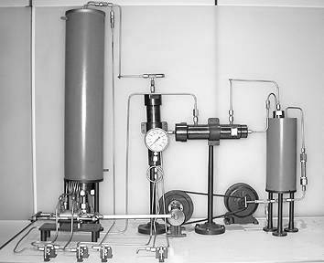
A Chemical Reaction Revolutionized Farming 100 Years Ago.
4
AMMONIA PRODUCTION ON A LARGE SCALE
The Haber-Bosch process and its role
“The Haber-Bosch process is the primary method in producing ammonia from nitrogen and hydrogen”
Haber first proposed (1908) the use of a high-pressure reaction technique. Furthermore, to overcome the low conversion-per-pass of ammonia, he introduced an important concept: the reaction rate, which is used in space-time yield to replace reaction yield;
With suitable catalysts, by circulating nitrogen and hydrogen over the catalyst at a pressure of 150–200 atm at a temperature of about 500°C, industrial-scale production could be realized;
Haber’s apparatus produced about 90 grams of ammonia per hour with about 98 grams of an osmium catalyst [1-4].
Fritz Haber's experimental plant for ammonia synthesis (German Museum Munich)
r=k⋅[N₂​]^{x}⋅[H₂​]^{y}
Space-time yield (STY): kg_{NH3} kg_{-cat}^{–1} h^{–1}
3H₂ + N₂ → 2NH₃ , ΔH = -92 Kj/mol
[1] Jennings, J.R., Catalytic Ammonia Synthesis Fundamentals and Practice.
[2] Topham, S.A., Catalysis, Science and Technology, ed. M.B. John R. Anderson. Vol. 7. 1985, Berlin: Springer-Verlag.
[3] Haber, F., Z. Elek., 1910. 16: p. 244.
[4] Haber, F. and R.L. Rossignol, Z. Elek., 1913. 19: p. 53.

Slide 9
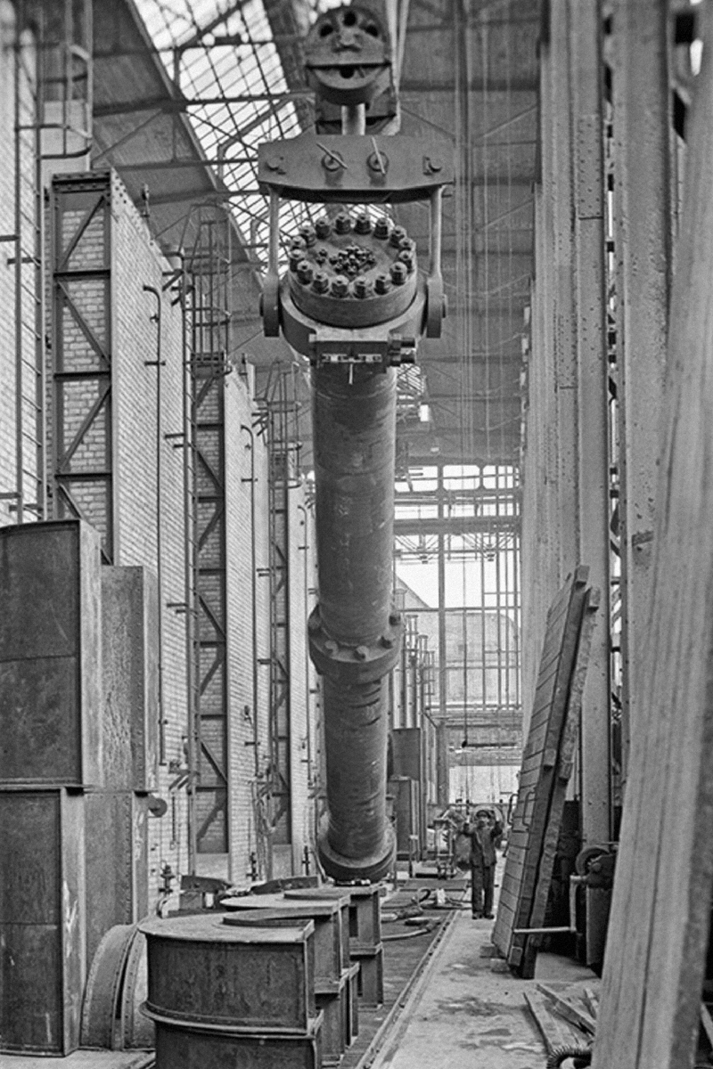
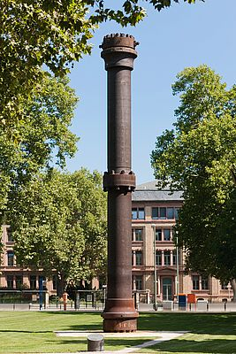
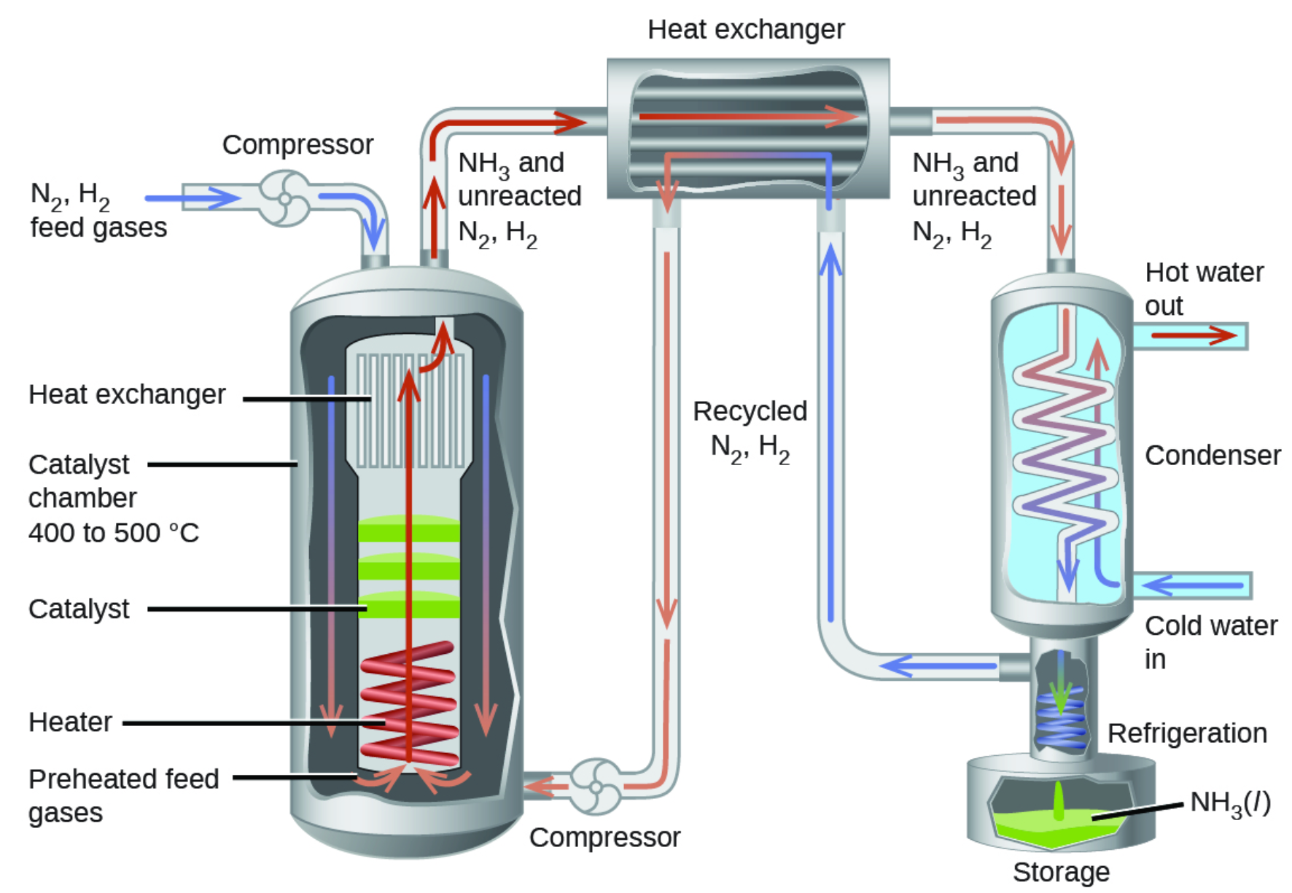
4
A Chemical Reaction Revolutionized Farming 100 Years Ago.
AMMONIA PRODUCTION ON A LARGE SCALE
The Haber-Bosch process and its role
“The Haber-Bosch process is the primary method in producing ammonia from nitrogen and hydrogen”
From 1909 until 1913, Carl Bosch (BASF) transformed Fritz Haber's tabletop demonstration of a method to fix nitrogen using high-pressure chemistry into an important industrial process to produce megatons of fertilizer and explosives;
To do this, he constructed a plant and equipment that would function effectively under high gas pressures and high temperatures;
The first full-scale Haber-Bosch plant was erected in Oppau, Germany (1913), now part of Ludwigshafen. This factory was able to produce 30 tons of ammonia per day with 300 Kg of the doubly promoted iron catalyst with a total pressure of 200 atmospheres of the nitrogen and hydrogen reactant gasses [1-2].
[1] Mittasch, A., Geschichte der Ammoniaksynthese. 1951, Weinheim: Verlag Chemie.
[2] Partington, J.R. and L.H. Parker, The Nitrogen Industry. 1922, London: Constable.
20 m high-pressure steel reactor for Haber process at the Karlsruhe Institute of Technology, Germany.

Slide 10
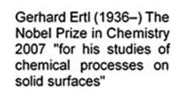
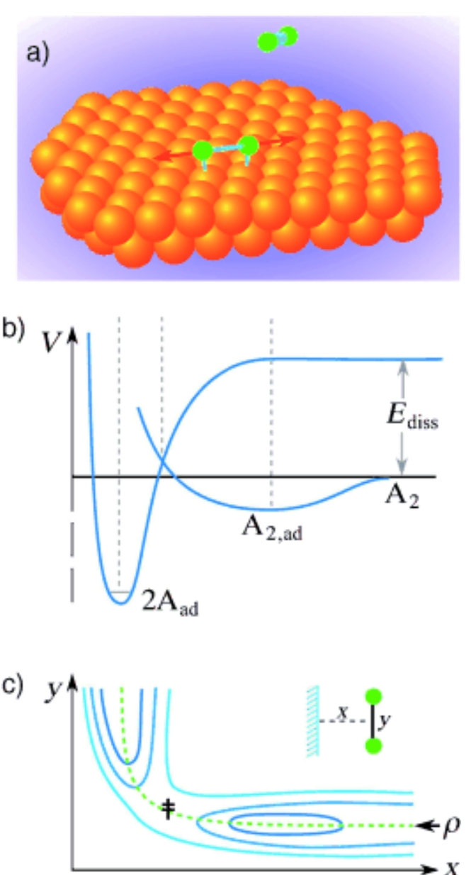
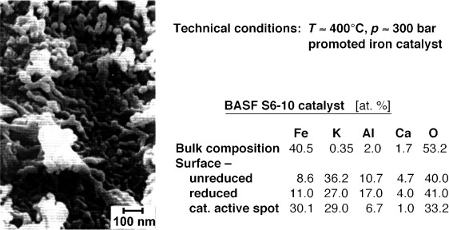
4
A Chemical Reaction Revolutionized Farming 100 Years Ago.
AMMONIA PRODUCTION ON A LARGE SCALE
The Haber-Bosch process and its role
“The Haber-Bosch process is the primary method in producing ammonia from nitrogen and hydrogen”
The detailed molecular mechanisms of the catalytic synthesis of ammonia over iron was studied and developed by Gerhard Ertl;
Ertl's contributions likely involved detailed studies of the surface chemistry of iron during the ammonia synthesis reaction, exploring how the catalyst interacts with the reactants and influences the reaction kinetics;
Surface science techniques, such as scanning tunnelling microscopy and spectroscopy, have been crucial in Ertl's research and in understanding the intricacies of catalytic reactions at the molecular level.
These methods allow scientists to investigate the structure of catalyst surfaces and the adsorption/desorption processes that occur during catalysis.
a) Illustration of the process of dissociative chemisorption of a diatomic molecule; b) one-dimensional Lennard–Jones diagram;
c) two-dimensional representation of equipotential lines as function of the distance x of the molecule from the surface and the separation y between the two atoms.
Surface topography and chemical composition of an industrial ammonia synthesis catalyst

Slide 11
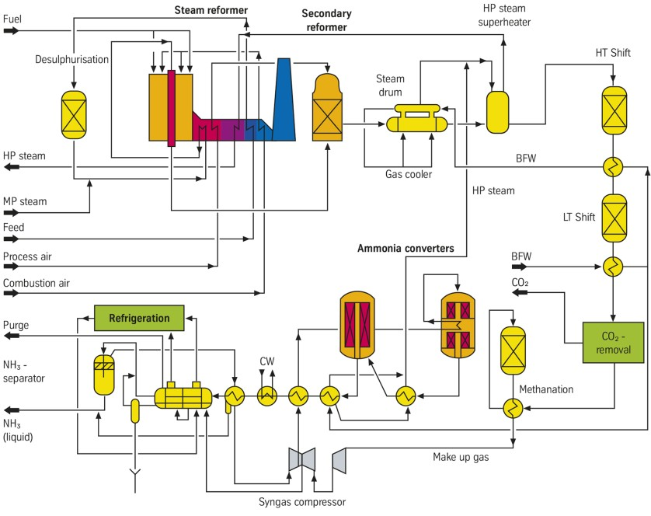
4
Flow Diagram for the Multi-step
Haber-Bosch Ammonia Production Process
AMMONIA PRODUCTION ON A LARGE SCALE
The Haber-Bosch process and its role
“The Haber-Bosch process is the primary method in producing ammonia from nitrogen and hydrogen”
The main features of Uhde Ammonia Processes (Thyssenkrupp) are a top-fired primary reformer with a cold outlet manifold, a secondary reformer with a circumferential vortex burner and a magnetite-based three-bed radial heat exchange synthesis with one or two synthesis converters.
Carbon monoxide is converted to carbon dioxide in the HT and LT shift over standard catalysts. Carbon dioxide is removed in a scrubbing unit, which normally uses the BASF-OASE or the UOP-Benfield process. Remaining carbon oxides are reconverted to methane by catalytic methanation at trace ppm levels.
Daily production capacity: 1000 - 2200t
Efficiency: 65%
Gas velocities: 10000–20000 m³ /m_{cat.}³ h
Typical conversions: 8–15%

Slide 12
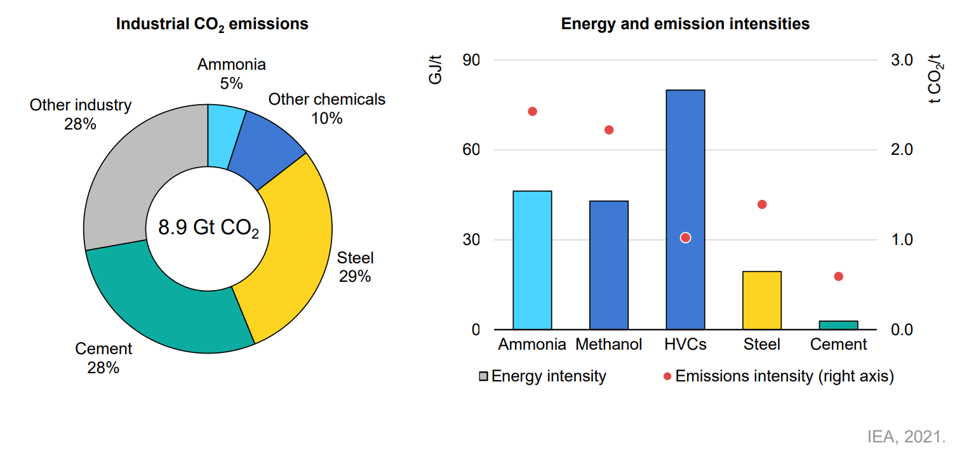
4
Flow Diagram for the Multi-step
Haber-Bosch Ammonia Production Process
AMMONIA PRODUCTION ON A LARGE SCALE
The Haber-Bosch process and its role
“The Haber-Bosch process is the primary method in producing ammonia from nitrogen and hydrogen”
Most ammonia plants rely on the steam reformation of natural gas to produce hydrogen and carbon dioxide. Coal, heavy fuel oil and naphtha can also be used but have higher carbon dioxide emissions (between 2.5 and 3.8 tonnes CO₂ / tonne ammonia compared to 1.6 tonnes CO₂ / tonne ammonia for natural gas).
Daily production capacity: 1000 - 2200t
Efficiency: 65%
Gas velocities: 10000–20000 m³ /m_{cat.}³ h
Typical conversions: 8–15%

Slide 13
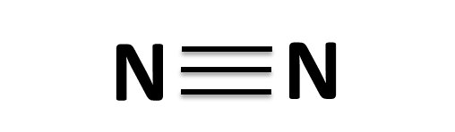



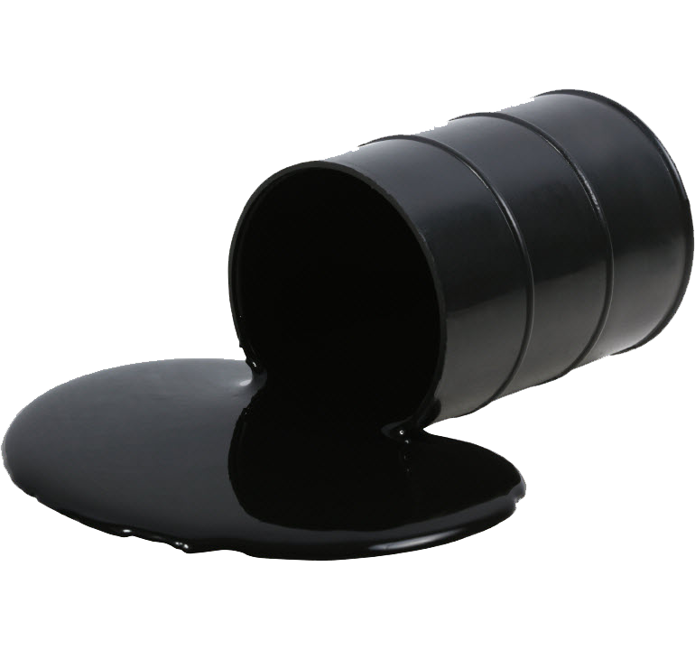
4
AMMONIA PRODUCTION ON A LARGE SCALE
The Haber-Bosch process and its role
“In terms of energy consumption, ammonia production still consumes 2% of the total energy supply in the world
“Drawbacks”
3H₂ + N₂ → 2NH₃ , ΔH = -92 Kj/mol
Energy-hungry
(0.58 MJ/mol_{NH3} – 0.81 MJ/mol_{NH3})
Ammonia synthesis is deceptively simple
Easy to find, hard to use (limiting step: activation of the stable N≡N bond, 945 kJ mol⁻¹)
“Ammonia production releases more than 400Mt. of CO₂”
Under pressure and temperature
(150 – 200 bar, ≈ 500°C)
1.6% of total anthropogenic
CO₂ emissions
Fossil fuels based (not sustainable )
6H₂O + 3CH₄ + 4N₂ → 3CO₂+ 8NH₃

Slide 14
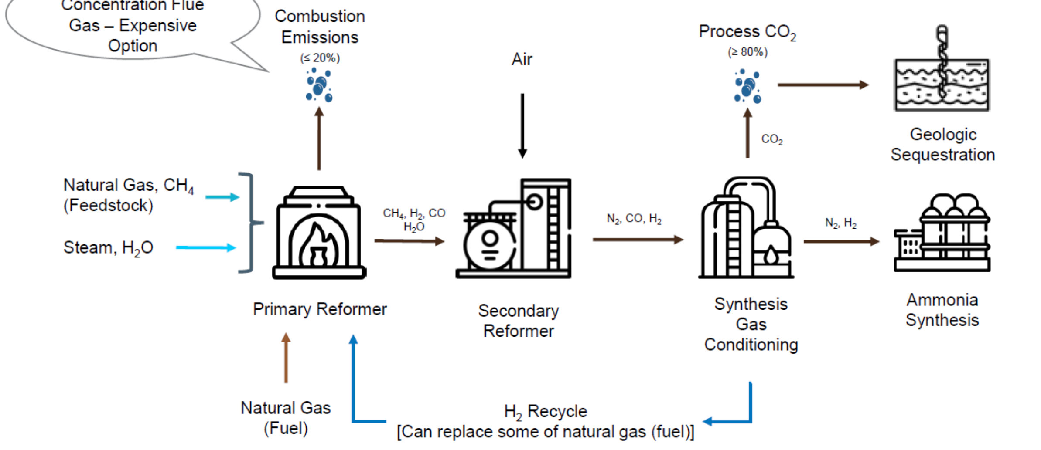
5
THE DECARBONISATION OF AMMONIA PRODUCTION
Steam methane reforming with Process Carbon Capture
Blue Ammonia and green ammonia
“Hydrogen accounts for around 90% of the carbon emissions in
the synthesis of ammonia”
Reducing the amount of carbon dioxide produced during the manufacturing process is dependent primarily on the source of hydrogen, using low-carbon energy for the process and system integration to produce the most efficient overall process.
The pathway to decarbonization
starts with blue
Blue or low carbon Ammonia production
Using blue hydrogen from steam methane reforming (SMR) with carbon capture and storage (CCS);
Steam methane reforming emits carbon dioxide in a concentrated form that is well-suited for carbon capture and storage;
While up to 90% of carbon dioxide could be captured, the upstream greenhouse gas emissions associated with natural gas extraction, limit the life-cycle emission reductions for combined steam methane reforming and carbon capture and storage to 60 – 85%;
This degree of carbon emission reduction is impressive but, for net-zero carbon hydrogen production, current projections suggest that this process can only be part of a transition to a zero-carbon solution.
Blue NH₃ is a responsible way of producing ammonia that integrates carbon capture to minimize
GHG emissions

Slide 15
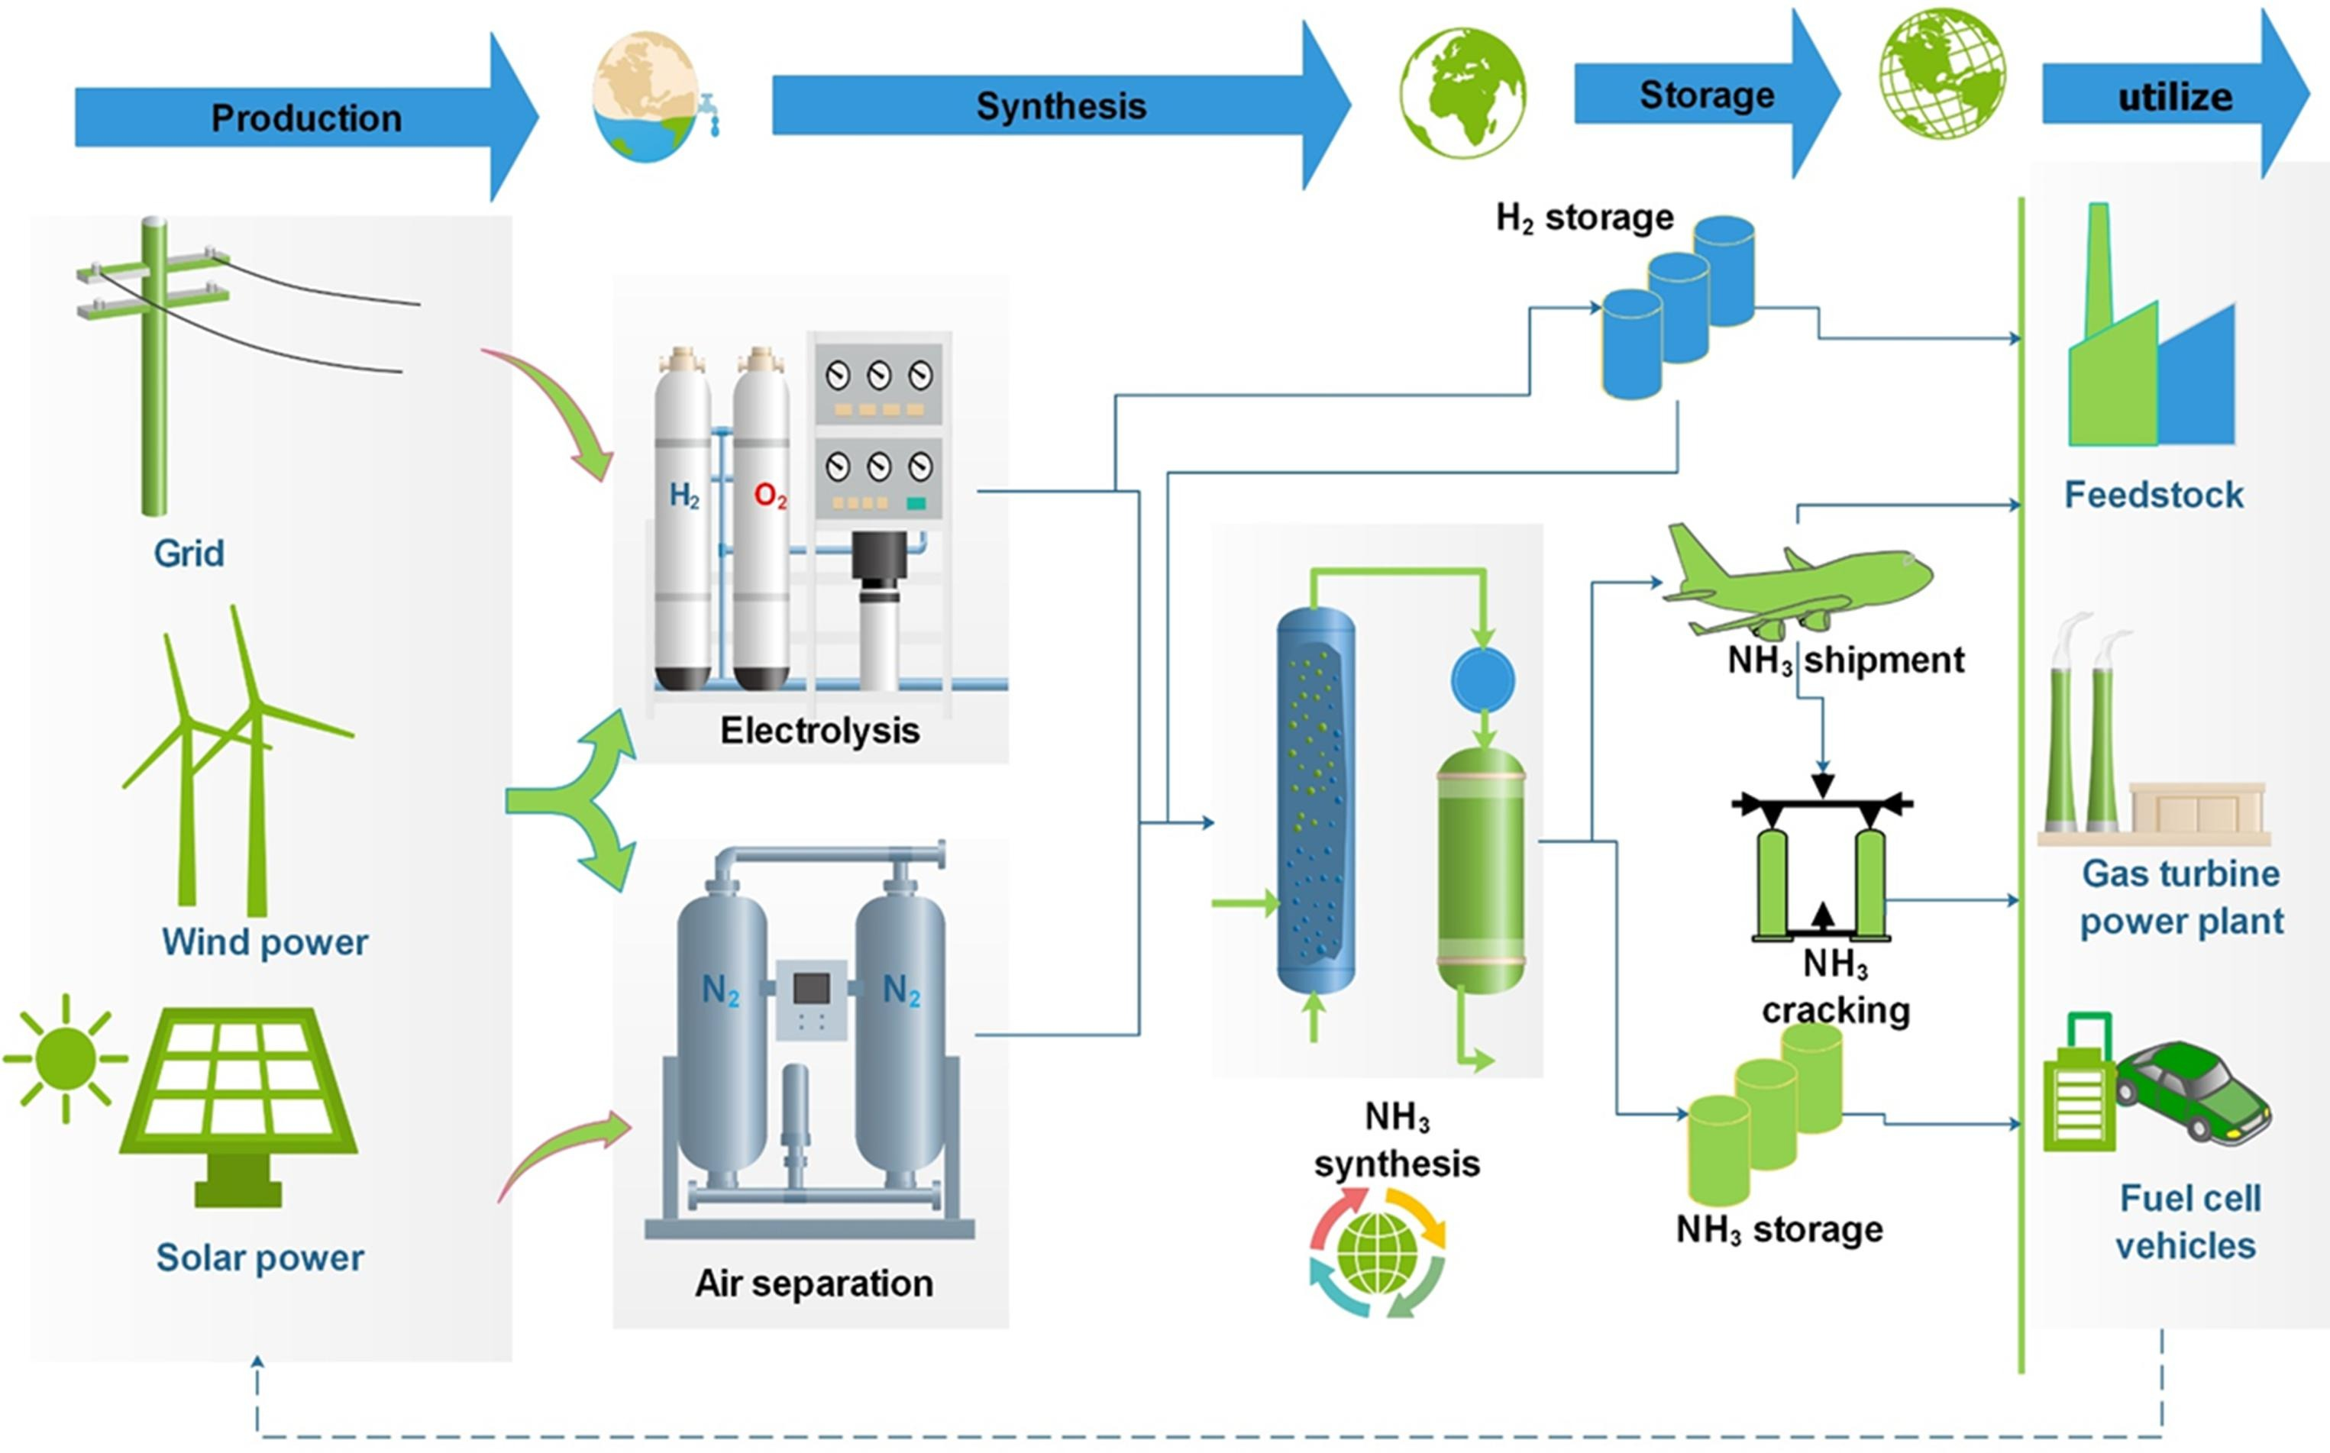
5
THE DECARBONISATION OF AMMONIA PRODUCTION
Blue Ammonia and green ammonia
“Hydrogen accounts for around 90% of the carbon emissions in
the synthesis of ammonia”
Reducing the amount of carbon dioxide produced during the manufacturing process is dependent primarily on the source of hydrogen, using low-carbon energy for the process and system integration to produce the most efficient overall process
Green Ammonia production
Ammonia has been recognized as an economically viable and carbon-free carrier for transporting and storing hydrogen due to its properties: stability under conditions close to atmospheric, high hydrogen content (17.6 wt%), existing infrastructures;
The interest in ‘green ammonia’, produced using green hydrogen (instead of being derived from natural gas via SMR), is driven both by the need to decarbonize the current ammonia production for its existing uses and by the potential of ammonia to serve as an economically viable carrier for long-distance transportation of green hydrogen.
Conversion to ammonia could be the most
cost-competitive solution for long-distance hydrogen transportation
Distributed ammonia plant will offer liquid storage of renewable electricity at ambient pressure and low boil-off conditions.
Ammonia can then be safely transported by road or rail to the user or used locally giving birth to local industrial ecosystems.

Slide 16
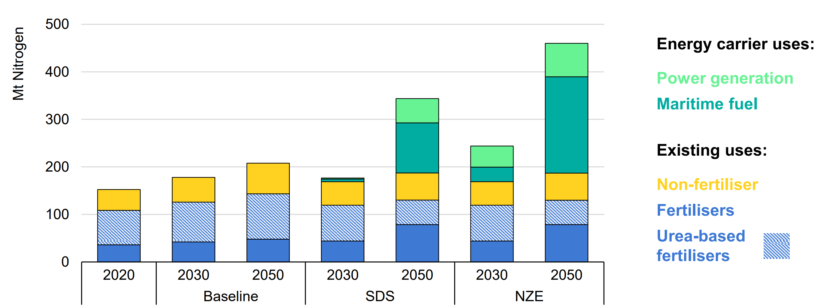
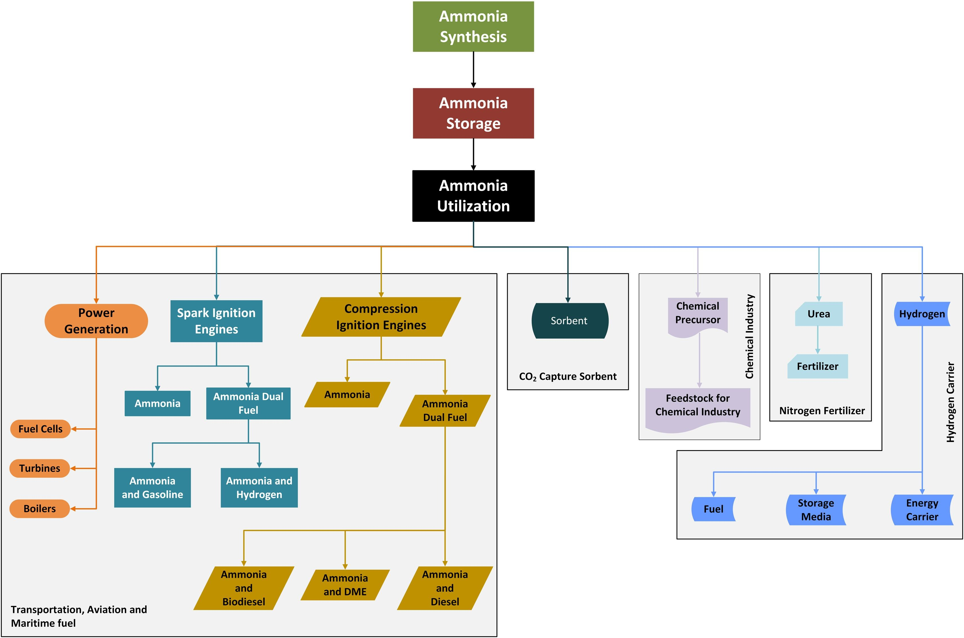
5
THE DECARBONISATION OF AMMONIA PRODUCTION
Nitrogen demand by end use and scenario
Layout of blue - green ammonia economy
Ammonia demand for fertilisers and other existing uses grows by 25% by 2050 in the Sustainable Development and Net Zero Emissions by 2050 scenarios. Use in the form of urea declines to reduce use-phase emissions..
Ammonia economy has the potential for four energy-related markets including
(i) ammonia as transportation fuel,
(ii) ammonia for heating applications,
(iii) ammonia for electricity generation
(iv) ammonia as hydrogen feedstock.

Slide 17
Flow Diagram for typical electrified
Haber-Bosch plant configuration
5
THE DECARBONISATION OF AMMONIA PRODUCTION
Green Ammonia production
Electrolyser
“Transitioning from conventional ammonia to green ammonia presents several challenges”
The capital expenditure for a green ammonia production plant is dominated by the electrolyzer cost;
These costs are based on an assumed CAPEX of USD 183/kg of NH₃/day for the HB plant and USD 800/kW for the alkaline electrolyzer, which can be considered as referential;
H₂
Air
Mixer
N₂
ASU
Compressor
CAPEX, alkaline electrolysis plant
CAPEX, Haber-Bosch plant
486M$
Compressor
Mixer
183M$
H₂ + N₂
H₂ + N₂
+ NH₃
Condenser
Heat Exchanger
The positive news is that green hydrogen costs are decreasing significantly due to the availability of low-cost renewable energy and the rapid learning curve in the electrolyzer production industry, leading to electrolyzers with lower costs and higher efficiency.
NH₃
Haber-Bossch Reactor

Slide 18
Flow Diagram for typical electrified
Haber-Bosch plant configuration
5
THE DECARBONISATION OF AMMONIA PRODUCTION
Green Ammonia production
Electrolyser
“Transitioning from conventional ammonia to green ammonia presents several challenges”
The HB process has been optimized for over a century to operate in conjunction with SMR plants, relying heavily on the residual heat generated during the SMR process;
The HB process is known to have low flexibility, meaning that it is challenging and time-consuming to adjust the operational parameters of the process;
Controlling the mass flow into the reactor cannot be as rapidly executed as changes in hydrogen production when derived from an electrolyzer connected to RES with an inherently variable production profile (storage and buffer stages between the green hydrogen production phases and the HB inlet are required);
Haber-Bosch plants are designed for 24/7 operation, and the typically sized HB+ASU (air separation unit) plant will require between 28 and 44 MW of 24/7 electricity supply;
H₂
Air
Mixer
N₂
ASU
Compressor
Compressor
Mixer
H₂ + N₂
H₂ + N₂
+ NH₃
Condenser
Heat Exchanger
Energy demand H₂ production (24/7)
374 MW
35MW
The energy supply for green hydrogen feedstock is significantly greater than the electricity demand for the HB process.
NH₃
Haber-Bossch Reactor
Energy demand, Haber-Bosch process

Slide 19
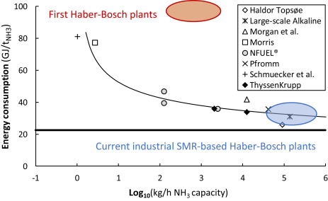

5
THE DECARBONISATION OF AMMONIA PRODUCTION
Energy consumption of various electrolysis-based Haber-Bosch processes (academic and industrial estimates).
The bold line represents the thermodynamic minimum energy consumption (22.5 GJ/t_{NH3})
Scale-Down and Intermittency issues
“Renewable sources of energy such as biomass, solar, wind or geothermal are characterized by a highly distributed production across regions”
Distributed production corresponds to the production at small scales, for green ammonia production the step forward is dawn-size of large-scale plant and modularization;
A large-scale ammonia plant (≥1000 t_{NH3}/d) consumes about 2–7 GJ/t_{NH3} for pressurizing, heating, pumping and utilities;
At intermediate scales (3–20 t_{NH3}/d), this energy consumption increases to typically 13–14 GJ/t_{NH3} ;
At very small scales (<0.1 t_{NH3}/d), heat is even required to keep the ammonia synthesis reactor at the synthesis temperature due to radial heat losses, and hydrogen and nitrogen production also becomes less efficient
Intermittent solar power and wind power cause variations in electricity supply. Therefore, the synthesis loop should either be able to ramp up and down fast, or batteries should be installed to operate the synthesis loop at constant load
Upon scale-down, heat losses increase and the energy consumption increases
Milder operating conditions in the synthesis loop are required for effective scale-down

Slide 20
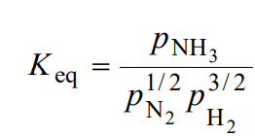
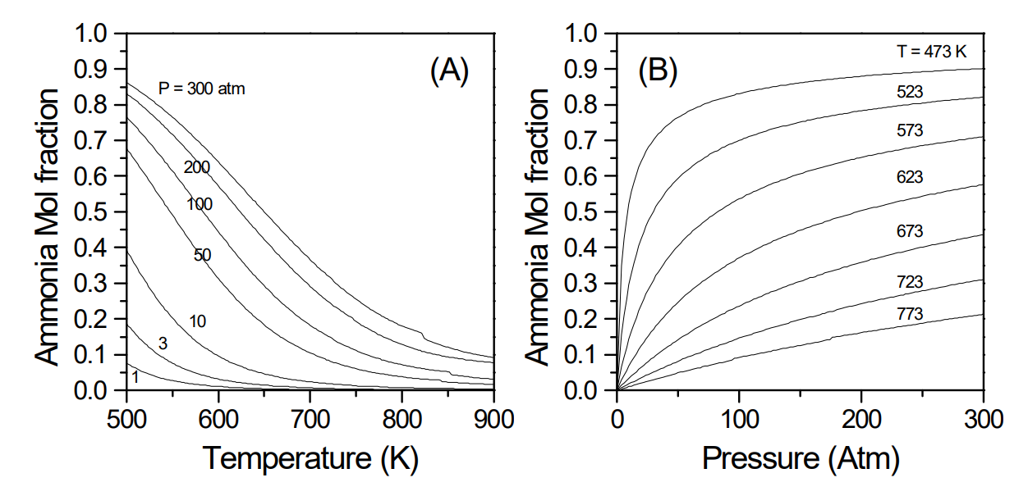
6
AMMONIA SYNTHESIS: THERMODYNAMIC EQUILIBRIUM
1/2H₂ + 3/2N₂ ⬄ NH₃ , ΔH = -45.7 Kj/mol
Temperature & pressure
Equilibrium constant :
“The conversion of nitrogen gas and hydrogen gas into ammonia occurs through a reversible reaction”
The reaction is a reversible reaction, that is, it can proceed both in forward direction (ammonia synthesis) and backward direction (ammonia decomposition);
The reaction is accompanied by decrease in volume because there is a decrease in number of moles of gas from 2 to 1;
By Le Chatelier’s Principle: (i) increasing the pressure causes the equilibrium to shift to the right resulting in a higher yield of ammonia since there is a pressure drop accompanying the transformation; (ii) decreasing the temperature also causes the equilibrium position to move to the right again resulting in a higher yield of ammonia since the reaction is exothermic (releases heat);
The reaction does not proceed at ambient temperature because nitrogen requires a lot of energy to dissociate (945 kJ mol⁻¹);
In the gas phase this dissociation occurs only at around 3000°C. Even the hydrogen molecule, which has a weaker molecular bond, only dissociates markedly at temperatures above 1000°C;
Mole fraction of ammonia at equilibrium from an initial mixture of 1:3 N₂/H₂ gas: (A) at different temperatures for fixed value of pressure; (B) at different pressures at fixed value of temperature.

Slide 21
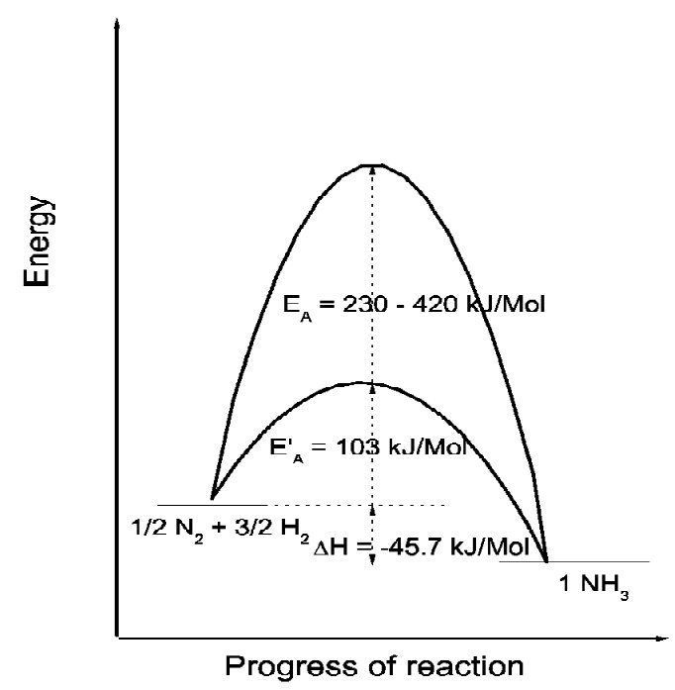
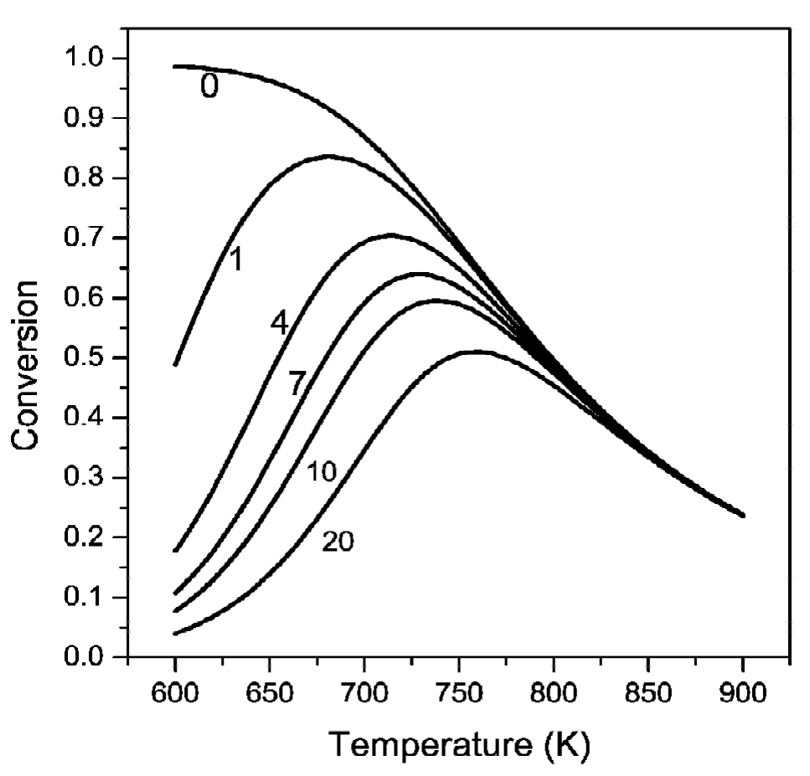
6
AMMONIA SYNTHESIS: THERMODYNAMIC EQUILIBRIUM
1/2H₂ + 3/2N₂ ⬄ NH₃ , ΔH = -45.7 Kj/mol
Temperature & pressure
Equilibrium constant :
“The reaction cannot be performed at lower temperature because it needs high energy, and if we increase the temperature to a high level, the reverse reaction predominates. This is clearly a vicious circle. This is where the role of the catalyst comes in”
The hydrogen and nitrogen molecules loose their translational degrees of freedom when bound to the catalyst surface, this reduces the activation energy dramatically and thus makes the forward reaction go faster;
This does not mean that we can go down to ambient temperatures! We still need reasonably high temperatures (250–400°C) to dissociate the N₂ and H₂ reactant molecules, even with the use of a catalyst. The use of a catalyst essentially provides a good trade-off. It accelerates the reaction sufficiently so that we can obtain ammonia at conditions where the equilibrium conversion is large enough to be useful;
The reaction rate depends on the temperature as well as conversion of the reactants. The contour of rate = 0 is the relationship between conversion and temperature at equilibrium;
At low conversion, higher temperatures can be maintained to achieve higher reaction rates, as the conversions increase, the temperature has to be decreased to overcome the limitations posed by the equilibrium (rate equals zero).
Energy profiles for ammonia synthesis: effect of catalyst on the activation energy.
Contours of constant reaction rate (Kg_{NH3}/m³ catalyst/hr) in the conversion-temperature phase plane

Slide 22
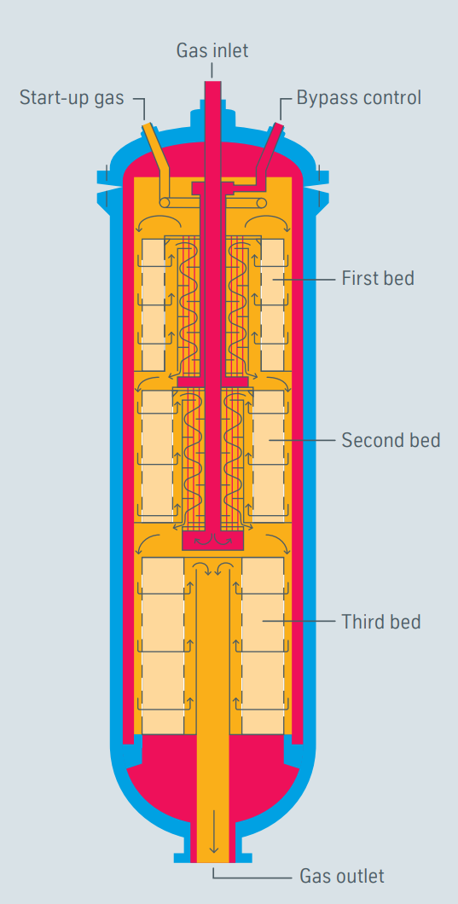
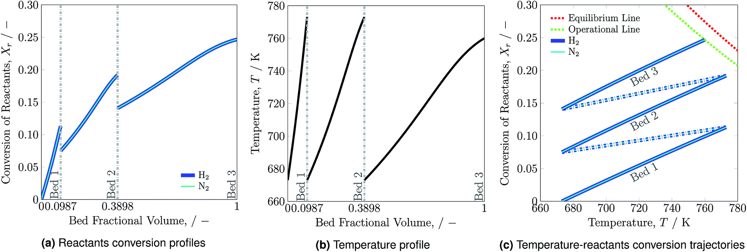
6
AMMONIA SYNTHESIS: THERMODYNAMIC EQUILIBRIUM
1/2H₂ + 3/2N₂ ⬄ NH₃ , ΔH = -45.7 Kj/mol
Temperature & pressure
Uhde Three-bed ammonia converters
(ThyssenKrupp)
“The reaction cannot be performed at lower temperature because it needs high energy, and if we increase the temperature to a high level, the reverse reaction predominates. This is clearly a vicious circle. This is where the role of the catalyst comes in”
The ammonia converters today combine the catalyst section and heat exchanger to achieve desired temperature profiles to strike a balance between higher rates of reaction and constraints posed by the equilibrium considerations;
Dual pressure process
(100 -200bar)
Reactants conversion (a), temperature profiles (b) and temperature-reactants conversion trajectories (c) for the reactor system along the catalyst beds

Slide 23
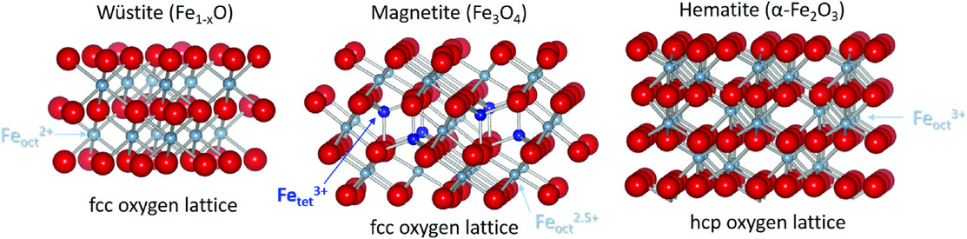
7
IRON CATALYSTS
The heart of large-scale ammonia plant
“For a given operating pressure and desired production, it determines the operating temperature range, recycle gas flow, and refrigeration requirement”
Perspective side views of Fe-oxide crystal structures. (G. S. Parkinson, Surf. Sci. Rep. 2016, 71, 272)
Promoted Fe-Based Catalysts
Industrial catalysts for ammonia synthesis must satisfy the following requirements:
The majority of catalyst development over the last century was devoted to the promoters of the magnetite catalysts that were used to increase both catalytic activity (through electronic promotion effects) and structural resistance;
In general, the catalysts contain varying quantities of oxides of aluminum, potassium, calcium, magnesium, and silicon as promoters;
Potassium (K): It is believed to enhance the activity of the catalyst by promoting the dissociation of hydrogen molecules and facilitating the adsorption of nitrogen;
Alkali and Alkaline Earth Metals (e.g., K, Na, Ca): These metals are often used as promoters to modify the surface properties of the iron catalyst, improving its catalytic activity and selectivity. They can also influence the electron distribution in the catalyst, leading to enhanced performance.;
Promoters for Electronic Structure Modification: Certain elements, such as chromium (Cr) and manganese (Mn), can be used to modify the electronic structure of the iron catalyst. This modification is aimed at improving the catalytic performance and stability under reaction conditions.
Promoters for Structural Support: Silica (SiO₂) or alumina (Al₂O₃) are sometimes used as promoters to provide structural support for the iron catalyst. This can enhance the stability of the catalyst and prevent sintering or agglomeration during the reaction.
Under normal operating conditions (14–45 MPa, 380–550 C, and 10,000–20,000 m³ m⁻ ³ h⁻¹ (STP)), the optimal activity corresponds to a composition of 2.5%–3.5% CaO, 2.3%–5.0% Al₂O₃, 0.8%–1.2% K₂O, and 0–1.2% SiO₂.
Less active but more poison- and temperature-resistant catalysts containing up to 3.6% magnesium oxide were recommended for older plants, for example, classical Casale plants, which operated at up to 80 MPa (800 bar) pressure and in which catalyst end temperature reached 650°C.
High catalyst activity at the lowest possible reaction temperatures so to use the favorable thermodynamic equilibrium situation - Average commercial catalysts yield about 25 vol% ammonia when operating at 40 MPa (400 bar) and 480°C catalyst end temperature, which corresponds to a 535°C equilibrium temperature;
High insensitivity or resistance to oxygen- and chlorine-containing catalyst poisons, which may be present also in the very effectively purified synthesis gas of a modern process;
Long lifetime, determined essentially by resistance to thermal degradation and to irreversible poisoning - In modern single-train ammonia plants, conventional iron catalysts achieve service lifetimes up to 14 years;
Mechanical strength. Insufficient pressure and abrasion resistance may lead to an excessive increase in converter pressure drop and so to a premature plant shutdown;
Reliable primary raw material source. Because of the high and increasing world demand for ammonia.
Early Development of Iron-Based Catalysts
“Fused-iron catalysts are by far the most studied and widely applied of all the ammonia synthesis catalysts”
Fused-iron catalysts are derived from three possible iron oxides, Fe₂O₃ (hematite), Fe₃O₄ (magnetite), and Fe_{1−x}O (wüstite);
The catalysts are produced in the same way today. Exact ratios of starting materials are mixed together and fused at around 1600°C. The main differences are additional promoters and the exact quantities and ratios of promoter species. The molten material is cooled and broken to the required size range.

Slide 24
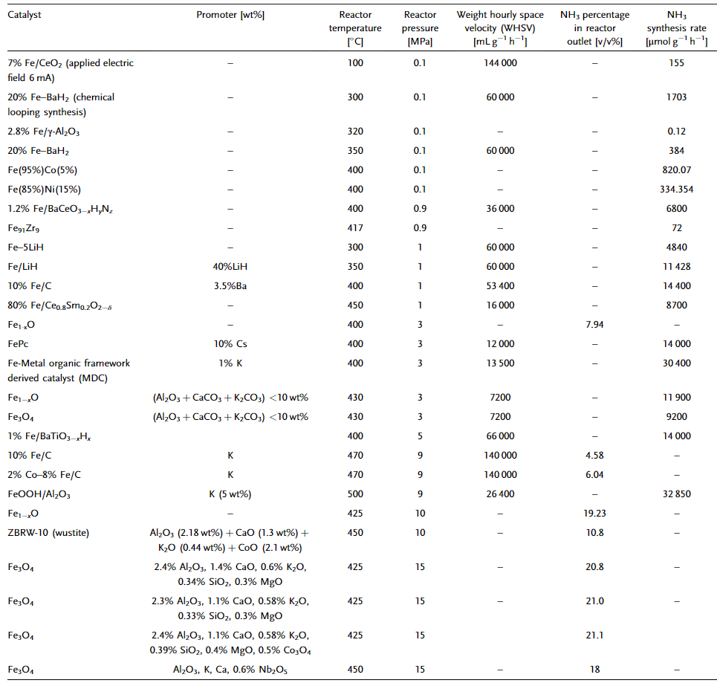
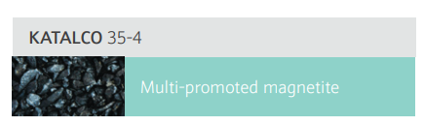
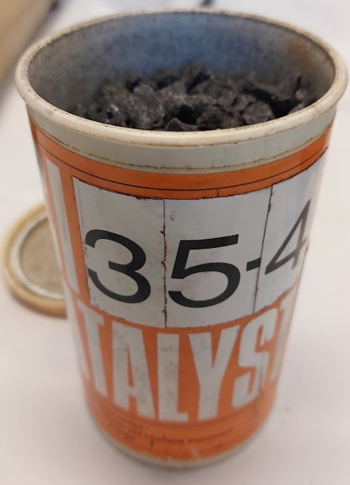
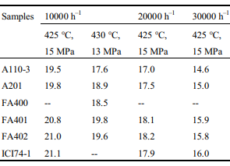
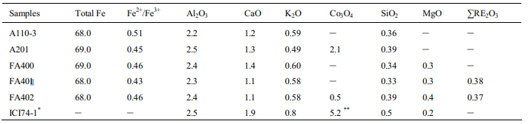
7
IRON CATALYSTS
Promoted Fe-Based Catalysts
“Different promoter combinations and catalyst formulations have been explored to optimize ammonia synthesis for improved efficiency, selectivity, and sustainability”
Perspective side views of Fe-oxide crystal structures. (G. S. Parkinson, Surf. Sci. Rep. 2016, 71, 272)
Under normal operating conditions (14–45 MPa, 380–550 C, and 10,000–20,000 m³ m⁻ ³ h⁻¹ (STP)), the optimal activity corresponds to a composition of 2.5%–3.5% CaO, 2.3%–5.0% Al₂O₃, 0.8%–1.2% K₂O, and 0–1.2% SiO₂.
Less active but more poison- and temperature-resistant catalysts containing up to 3.6% magnesium oxide were recommended for older plants, for example, classical Casale plants, which operated at up to 80 MPa (800 bar) pressure and in which catalyst end temperature reached 650°C.
Comparing the results is challenging because the operating conditions are quite different. Generally, the Al₂O₃, K₂O, CaO, and SiO₂-promoted iron catalysts exhibit high activity with an ammonia concentration of 15–20% at the convertor outlet achieved for space velocities of 30 000 –10 000 h⁻¹ at 425 °C and 150 bar;
Compositions (wt.%) of various Iron promoted catalysts
NH₃ concentration (%) of various iron catalysts at different reaction conditions
https://doi.org/10.1002/aesr.202000043
JOURNAL OF RARE EARTHS, Vol. 26, No. 5, Oct. 2008, p. 711

Slide 25
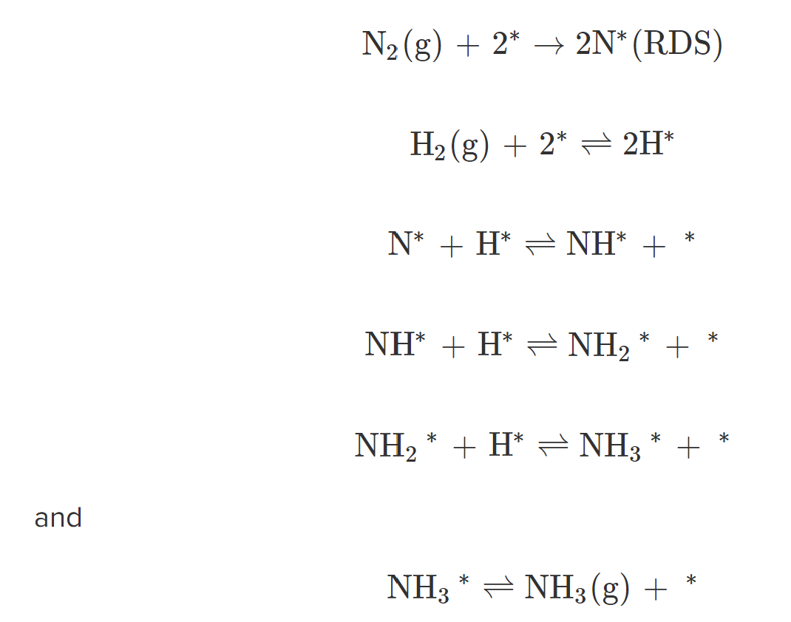
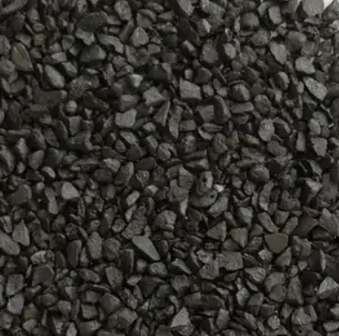
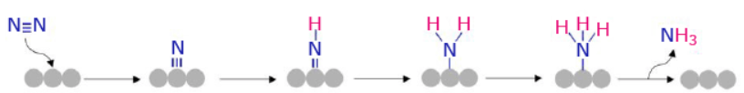
7
Mechanism of ammonia synthesis in the pressure range of industrial interest
IRON CATALYSTS
The generally accepted mechanism for ammonia synthesis on Fe is known from experiment, and it is a Langmuir–Hinshelwood mechanism in which the first step is also the rate-determining step (RDS).
Catalyst size and shape
“The choice of particle size and shape of commercial ammonia catalysts is determined mainly by two factors: (1) Catalyst performance (2) Pressure drop”
For processes operating at pressures of 25–45 MPa (250–450 bar) and at space velocities of 8000–20,000 m³ m⁻ ³ h⁻ ¹ (STP), a grain size of 6–10 mm is preferred;
Large grain size retards transport of the ammonia from the particle interior into the bulk gas stream, because this proceeds only by slow diffusion through the pore system, so decreasing the reaction rate. At the high reaction rate typical for the converter inlet layer, only a surface layer of the catalyst grains, about 1–2 mm thick, participates in the reaction;
Catalyst Reduction
The mechanism proceeds via the adsorption of dinitrogen onto the catalyst surface. This is followed by dissociation to adsorbed nitrogen atoms, which is the rate determining step. Direct dissociative adsorption of H₂ to hydrogen atoms proceeds, followed by the stepwise addition of hydrogen atoms to the nitrogen atoms to sequentially form adsorbed NH, NH₂ and NH₃ species, and finally desorption of the NH₃ product.
“To ensure maximum effectiveness of the catalyst, a defined reduction procedure must be followed”
The reduction should be carried out at high gas velocities (about 5000–15,000 m³ m⁻ ³ h⁻ ¹ (STP)), at the lowest temperatures sufficient for complete reduction and at not too high pressures (7–12 MPa in low-pressure and 25–30 MPa in high-pressure plants), assuring a better control of the exothermic formation of ammonia during the reduction;
High temperature and high water vapor partial pressure markedly accelerate premature catalyst aging by recrystallization.

Slide 26
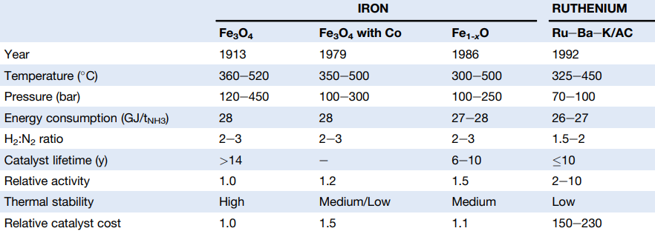
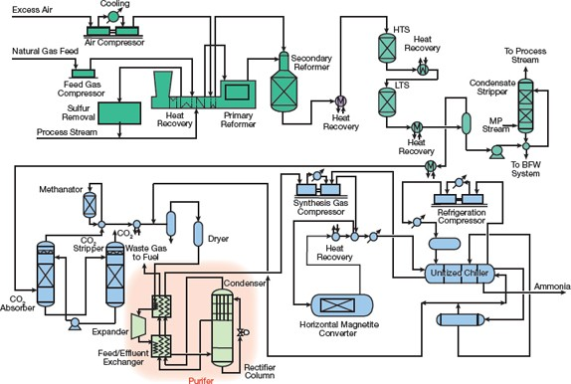
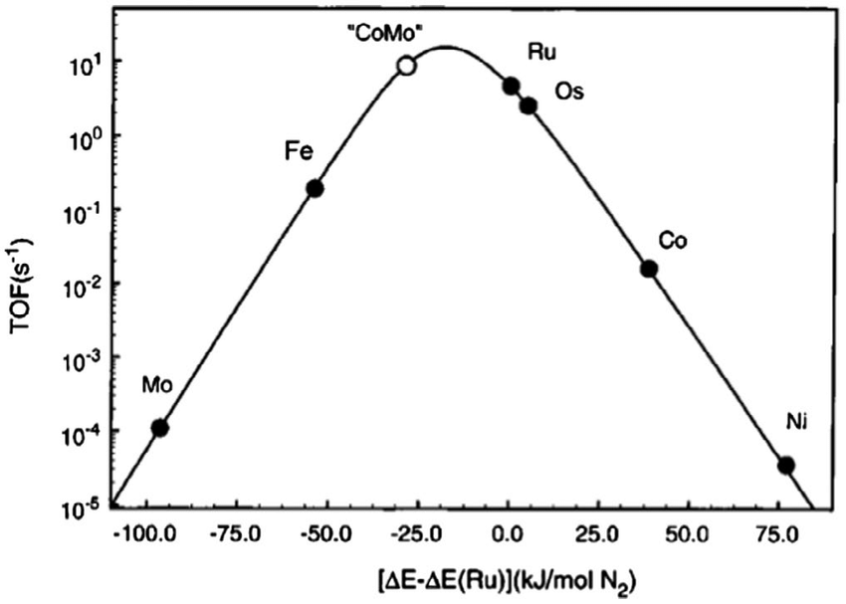
7
RUTHENIUM-BASED CATALYSTS
Comparison of SMR-Based Ammonia Synthesis Processes with Commercial Iron-Based and Ruthenium Based Catalysts.
Supported Ru Catalysts
“Supported ruthenium catalysts are the second most common ammonia synthesis catalyst and the only other to be used industrially for ammonia synthesis.”
The discovery and optimization of these 2nd-generation catalysts (i.e., ruthenium over carbon normally promoted with Cs or Ba) led to a new industrial process for the production of ammonia called the Kellogg Advanced Ammonia Process (KAAP), in which it is possible to obtain yields of 40–50%, at lower temperatures (370–400 °C) and pressures (50–100 bar) as compared to the conventional Haber–Bosch process using iron oxides as the catalyst;
Ruthenium is a more active catalyst for ammonia synthesis than iron, but ruthenium is more expensive, and it has a shorter lifetime than the Fe catalyst. Several strategies for the design of new catalyst based on Ru have been evaluated in order to increase the activity and stability of these kind of catalysts, with the objective of minimizing the amount of noble metal in the catalyst;
Volcano activity curve for ammonia synthesis. Ammonia synthesis rate as a function of the nitrogen adsorption energy over different transition metal catalysts. Copyright 2015, Elsevier.
Scheme of KBR (Kellogg Brown and Root) process
https://doi.org/10.1002/aesr.202000043

Slide 27
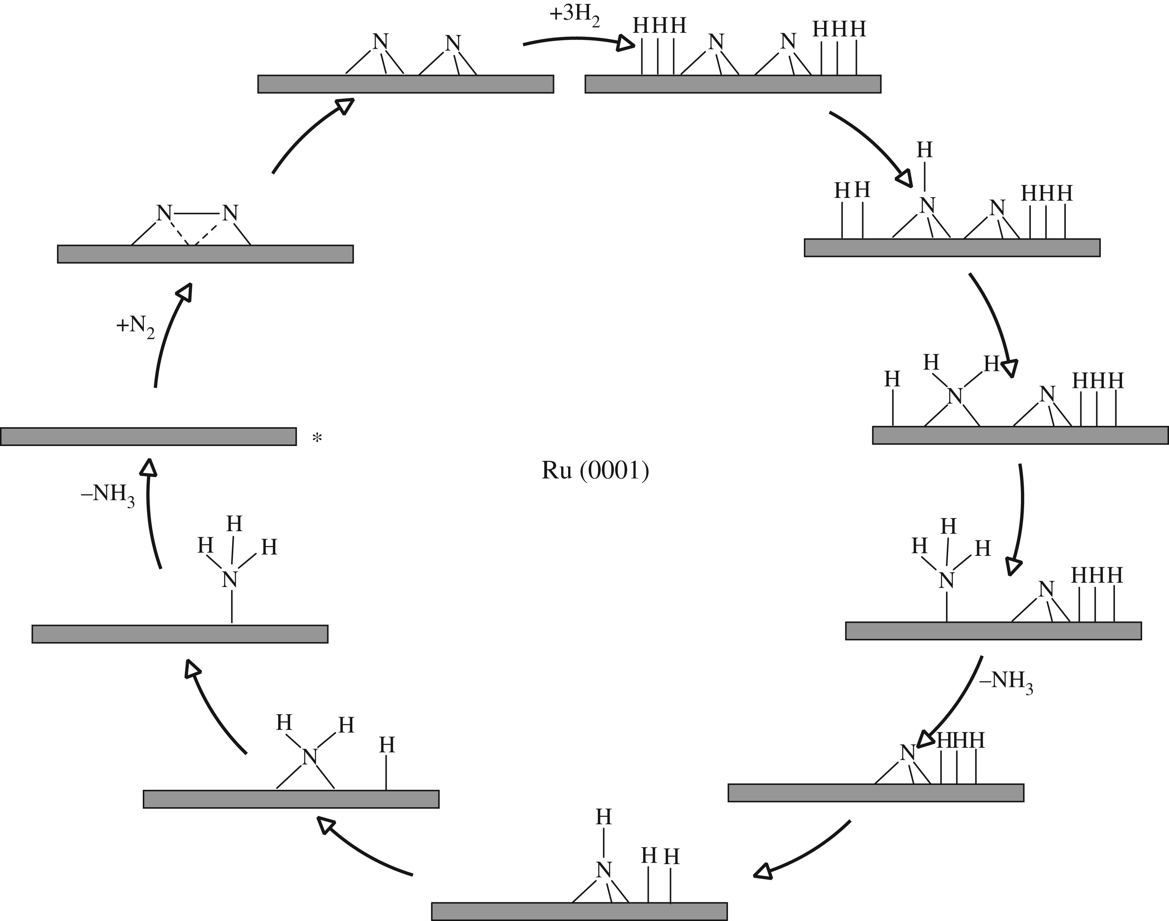
7
RUTHENIUM-BASED CATALYSTS
Simplified schematic of dissociative mechanism for ammonia synthesis on Ru(0001) surfaces according to the work of Logadóttir & Nørskov. Reaction starts at the asterisk.
Supported Ru Catalysts
“Supported ruthenium catalysts are the second most common NH₃ synthesis catalyst and the only other to be used industrially for NH₃ synthesis”
The RDS is the dissociation of N₂, which was calculated to have a lower barrier at steps.;
The dissociative mechanism is that of a typical Langmuir–Hinshelwood mechanism in which N₂ adsorbs dissociatively followed by the dissociation of three H₂ forming *N and *H species, respectively, These species are co-adsorbed on the surface of the catalyst in positions that allow the reaction of *H with *N;
In the next step, hydrogen atoms are added to nitrogen atoms forming first *NH, then *NH₂ and finally *NH₃ which desorbs from the catalytic surface.
After the desorption of the first NH₃, the remaining *N is hydrogenated via a similar process to the previous step, in order to form a second NH₃ molecule.
https://biblioproxy.cnr.it:2481/10.1002/

Slide 28
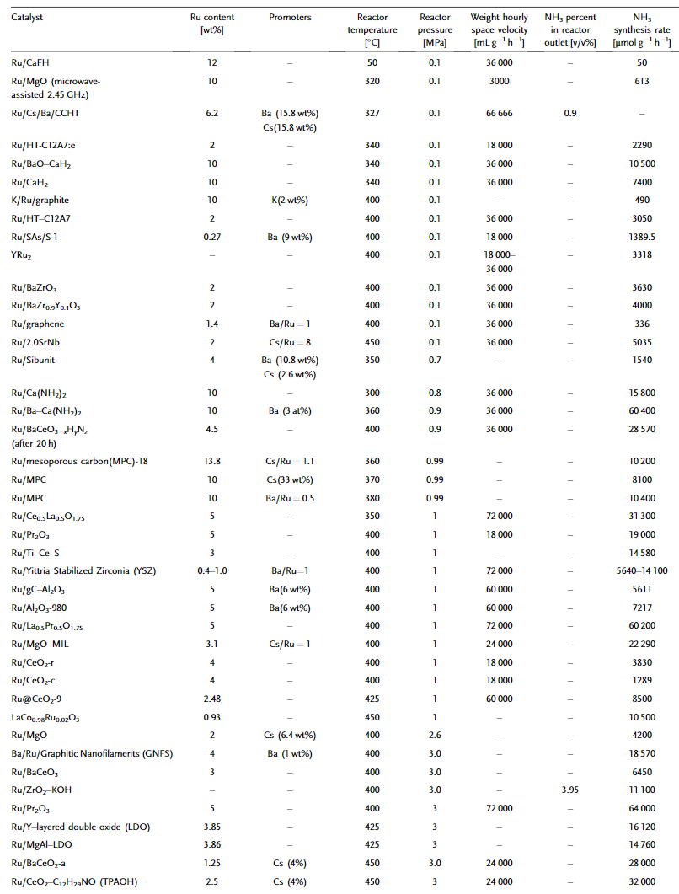



7
Chemical composition and activity of ruthenium catalysts for ammonia synthesis.
RUTHENIUM-BASED CATALYSTS
Supported Ru Catalysts
“Supported ruthenium catalysts are the second most common NH₃ synthesis catalyst and the only other to be used industrially for NH₃ synthesis”
Since 1979, when Ru was first supported on graphite carbon and used as an ammonia synthesis catalyst, it has gained a large portion of the research attention for ammonia synthesis catalysts, with a large number of different support materials investigated;
A major breakthrough in Ru-based catalysts was the classification of the B5-type site as the active site for Ru-based catalysts, the optimal Ru particle size required to maximize the amount of B5-type sites, with a Ru particle size of 2 nm found to be optimal;
Barium-promoted catalysts lead to more than double the yield of NH₃ compared with a cesium-promoted catalyst under roughly the same high-pressure conditions. To reach such a high yield with the industrial iron catalyst, a pressure of 10.7 MPa instead of 5 MPa (for the Ba-Ru/MgO system) and higher temperatures would be necessary;
As well as the reduction temperature, the barium promoter in Ru catalysts can increase the number of B5-type sites in the Ru catalyst through a reconstruction of the Ru catalyst's surface.
Disp. = 76%
Catalytic activity of a) the barium-promoted catalyst (Ba-Ru/MgO), b) the cesium-promoted catalyst (Cs-Ru/MgO), c) the industrial iron catalyst, d, e) unpromoted Ru/MgO catalysts (Ru/MgO), and f) values of ammonia mole fractions at equilibrium are shown.
TEM micrograph of the Ba-Ru/MgO catalyst after reduction at 783 K revealing the presence of very small Ru particles, approximately 2 nm in size
https://biblioproxy.cnr.it:2481/10.1002/
https://doi.org/10.1002/aesr.202000043

Slide 29


7
Chemical composition and activity of ruthenium catalysts for ammonia synthesis.
RUTHENIUM-BASED CATALYSTS
Supported Ru Catalysts
“Supported ruthenium catalysts are the second most common NH₃ synthesis catalyst and the only other to be used industrially for NH₃ synthesis”
The support morphology as well as synthesis and treatment methods can be shown to have a great effect on the activity of the catalyst;
Different activities are observed in Ceria-supported Ru catalysts because of the morphology treatment effects.
Low crystallinity of Ru species and high concentration of oxygen vacancies enhanced the adsorption of hydrogen and nitrogen and also led to desorption of surface hydrogen in the form of H₂;
Therefore, Ru/CeO₂ nanorods showed high ammonia synthesis activities (18 mmol g⁻¹ h⁻¹ at 400 °C and 1 MPa). On the contrary, lower catalytic activity (7.9 mmol g⁻¹ h⁻¹) was observed over Ru/CeO₂ nanocubes catalyst because H₂ and N₂ adsorption was less favorable plausibly due to the large particle size of Ru species and low concentration of oxygen vacancies, and most of the hydrogen species were consumed in H₂O formation.
ttps://biblioproxy.cnr.it:2481/10.1021/acs.iecr.8b02126
https://doi.org/10.1002/aesr.202000043

Slide 30


7
Chemical composition and activity of ruthenium catalysts for ammonia synthesis.
RUTHENIUM-BASED CATALYSTS
Supported Ru Catalysts
“Supported ruthenium catalysts are the second most common NH₃ synthesis catalyst and the only other to be used industrially for NH₃ synthesis”
The vast majority of ruthenium catalysts involve a large-weight-percentage support material with ruthenium particles located on the support surface; however, recently catalysts incorporating ruthenium into the support compound have been investigated;
Perovskite support LaCoO₃ can be doped with Ruthenium, added as a B-site dopant to get LaCo_{0.98}Ru_{0.02}O₃.
When this was compared to a conventionally supported Ru catalyst on LaCoO₃ at the same conditions (1 MPa, 450 °C), the activity increased from 4.9 to 10.5 mmol g⁻¹ h⁻¹ for the doped perovskite;
By substituting Co with Ru, then, a strongly synergistic effect can be achieved for these two species, both of which show activity for ammonia synthesis. This was found to benefit the dissociative adsorption of N₂ through the formation of more Ru clusters along with a larger Co surface presence.
DOI: 10.1021/acs.iecr.8b04915
https://doi.org/10.1002/aesr.202000043

Slide 31




7
RUTHENIUM-BASED CATALYSTS
Electride-Based Catalysts
“Ruthenium catalysts with inorganic electride support showed promising activities due to the excellent promotion effect of this recent material”
An electride is an O²⁻ ionic compound in which electrons act as the anion. Thus, electrides are materials that contain trapped electrons as structural components, rather than as mobile charge carriers. These trapped electrons can exhibit unique chemical reactivity, making electrides interesting candidates for catalysis.
Electrides inherently possess high electron density, which can influence the catalytic activity and selectivity of the material;
The mechanism of ammonia synthesis involves reversible storage and release of hydrogen atoms on the Ru/C12A7:e(-) surface i.
a) Ammonia synthesis rate and outlet ammonia mole fractions for Ru/C₁₂A₇:e⁻ compared with various supported Ru catalysts.
b) Apparent activation energy and turnover frequency for Ru/C₁₂A₇:e⁻ compared with various supported Ru catalysts. All catalysts were loaded with 1 wt% Ru and tested at 0.1 MPa, 400 °C, H₃/N₃ = 3, 60 mL min⁻¹.
Proposed reaction mechanism and energy profile for ​ammonia synthesis.
The rate controlling step of ammonia synthesis over Ru/C12A7:e(-) is not dissociation of the nitrogen-nitrogen triple bond but the subsequent formation of N-Hn species
Lattice structure of the [Ca₂₄Al₂₈O₆₄]4þ(e)4 electride with Ruloading. The structure shows how electrons occupy the oxygen vacanciesin the material. Reproduced with permission. Copyright Springer Nature 2012
https://doi.org/10.1002/aesr.202000043

Slide 32


8
COBALT-BASED CATALYSTS
Chemical composition and activity of cobalt catalysts for ammonia synthesis.
Supported Co catalysts
“In recent years, cobalt-based ammonia synthesis catalysts have attracted the attention of researchers because of their high activity. Like ruthenium, cobalt-based catalysts are commonly used with a support material”
Cobalt catalysts doped with cerium and barium: It has been found that ceria plays the role of a structural promoter; it hinders the sintering of Co₃O₄ during calcination and stabilizes the surface area of Co under reaction condition;
The co-promoted cobalt catalyst containing 11.5 wt% of CeO₂ (Co/Ce(11.5)/Ba) was shown to be more active in NH₃ synthesis than the conventional fused iron catalyst. The catalyst activity was measured at 400 °C with a pressure of 6.3 MPa and a gas mole ratio of H₂/N₂ of 3/1; at these conditions it was found that a cerium loading of 11.5 wt% provided the highest rate, with ammonia produced with a value of 3.33 g_{NH3} g⁻¹ h⁻¹;
Ba and Ce-promoted carbon-supported cobalt catalyst: Catalytic activity measurements were conducted at 9.0 MPa at a temperature of 400 °C using a stoichiometric gas flow of nitrogen and hydrogen. At these conditions it was found that a higher rate can be achieved when the catalyst is prepared through the coimpregnation method, with a rate of 8.16 g_{NH3} g⁻¹ h⁻¹;
https://doi.org/10.1002/aesr.202000043
Determined on the basis of hydrogen chemisorption studies (H₂-TPD experiments); ^{b} an average reaction rate under conditions: T = 400 °C, p = 6.3 MPa, H₂/N₂ = 3:1; ^{c} TOF (turnover frequency) estimated on the basis of the chemisorption data (H₂-TPD) and catalytic tests results;

Slide 33




9
METAL NITRIDE CATALYSTS
The rare earth metal nitrides such as CeN, LaN, and YN can act as efficient supports and/or catalysts for ammonia synthesis, in which nitrogen vacancy formation has a strong effect on the catalytic performance
Ternary nitride
“Metal nitride phases have also been reported for their high activity in the catalytic synthesis of ammonia”
One major development in metal nitride catalysts was the idea of ternary nitride systems;
If a ternary nitride is made by combining two metals, one with a too high nitrogen adsorption energy and one with a nitrogen adsorption energy that is too low, then an ammonia synthesis catalyst can be obtained with a TOF closer to the maximum than any single metal nitride;
In the Co–Mo catalyst system shown on the plot, Mo binds nitrogen too strongly, whereas Co binds nitrogen too weakly;
The Cs- or K-promoted Co₃Mo₃N catalysts exhibit a high activity of ≈900 μmol g⁻¹ h⁻¹ at 400 °C and 1 bar, which outperform the Fe-based catalysts under the same condition;
The cost of these nitride catalysts is much higher than that for fused-Fe catalysts, which is the major barrier for large-scale applications.
Reaction conditions: 0.1 g catalyst, N2:H2 = 15:45 mL min–1, 150–400 °C, 0.1 and 0.9 MPa
In the case of Ni-loaded nitrides, H₂ and N₂ are separately activated at Ni metal and V_{N} sites, respectively. Without Ni loading, V_{N} sites can activate both H₂ and N₂ simultaneously for stable ammonia production.
https://doi.org/10.1016/S0926-860X(01)00529-4
Calculated turnover frequencies for ammonia synthesis as a function of nitrogen adsorption energy (400 °C, 50 bar)

Slide 34






9
AMBHER PROJECT: ADVANCED CATALYSTS FOR NH₃ SYNTHESIS AT LOW PRESSURE AND TEMPERATURE
Integration of POCS catalysts with membranes in a membrane reactor
N₂
H₂
Ammonia and MOF Based Hydrogen storagE for euRope
AMBHER
Catalyst (coated)
AMBHER
Selective membrane
WP3
“Key materials and components for long term Hydrogen Storage”
retentate
AMBHER
Thermal conductive
metal
foam/POCS support
Task 3.1 - Lab-scale ammonia catalyst (TRL 3): Advanced synthesis, performance evaluation and identification of the promising formulation
Task 3.2 - In situ and operando catalyst characterization
Task 3.3: Bench-scale (TRL 4) 3D printed POCS and novel JM catalysts:
Task 3.4 - Development and characterization of NH₃ selective CMSM
NH₃ (permeate)

Slide 35









1
WP3 goals for Period 1 (M1-M18)
9
AMBHER Project Catalysts
Obj.2.
To develop an innovative Catalytic Membrane Reactor (CMR) to produce green ammonia, with production rate 4 times higher than conventional reactors operated at the same conditions.
2.1
To develop innovative environmentally friendly catalyst materials that can be used at much lower pressures and temperatures compared to the Haber-Bosch (H-B) process
Task 3.1- Lab-scale ammonia catalyst (TRL 3): Advanced synthesis, performance evaluation and identification of the promising formulation
Task 3.2 - In situ and operando catalyst characterization
First generation of novel catalysts based on nanoconfined metal hydrides/nitride
First generation of novel catalysts based on amide/imide/nitride-hydride solid solutions
Specific Objectives
First generation of novel catalysts based on transition metal nanocluster / nanoparticle
Task 3.3 - Bench-scale (TRL 4) 3D printed POCS and novel JM catalysts
Novel JM catalysts

Slide 36







1
WP3 goals for Period 1 (M1-M18)
9
AMBHER Project Catalysts
Obj.2.
To develop an innovative Catalytic Membrane Reactor (CMR) to produce green ammonia, with production rate 4 times higher than conventional reactors operated at the same conditions.
2.2
To develop innovative membranes for selective separation of NH₃ during production process
Task 3.4 - Development and characterization of NH₃ selective CMSM
CMSM membranes from previous studies
Specific Objective
First generation CMSMs
2.3
To design and manufacture highly conductive POCS with optimised heat and mass transfer
Task 3.3 - Bench-scale (TRL 4) 3D printed POCS and novel JM catalysts
Specific Objectives
First generation of POCS

Slide 37



1
9
AMBHER Project Catalysts
TASK 3.1: Lab-scale ammonia catalyst (TRL3)
Sub-task: Nanoconfined and highly dispersed Metal hydride-based catalysts sites [UU]
Synthesize alkali metal hydride confined in graphitic carbon support
Operating conditions:
10 bar, 250-400°C, 36,000 mL g_{cat}⁻¹ min⁻¹, N₂:H₂ = 1:3

Slide 38

1
9
AMBHER Project Catalysts
TASK 3.1: Lab-scale ammonia catalyst (TRL3)
Sub-task: Metal-nitrogen-hydrogen (M-N-H) mixed anion catalysts [UoB]
Synthesis of several first-generation catalyst formulations, including lithium nitride hydride, non-stoichiometric calcium nitride hydride and lithium-strontium nitride hydride
Inorganic solids containing single or mixed ions from among H⁻, N³⁻, NH²⁻ and NH₂⁻.These materials have generally been used in composite with transition metals, particularly ruthenium, to achieve high activities at mild-conditions.
The nature of the interaction has been proposed to take a number of forms:
The separation of nitrogen activation and NHx formation sites between the transition metal and the M-N-H material to “break” the scaling relationship between the N₂ adsorption transition-state energy and the adsorption energy of NH_{X} intermediates (x = 0, 1 and 2) that governs the performance of conventional TM-based HB catalysts.
The reversible storage of hydrogen/hydride in the M-N-H material to remove or reduce hydrogen inhibition effects on ruthenium.
The formation of strong metal-nitrogen bonds which anchor the active metal on the support and enhance favourable interactions.
Summary of key catalyst developments:
Li₄NH-TM
Activity of around 3 mmol_{NH3} g_{cat}⁻¹ hr⁻¹ @450°C, 2 bar, for Ni/Co composites.
Sr₂LiNH₂-TM.
Activity of around 3 mmol_{NH3} g_{cat}⁻¹ hr⁻¹ @450°C, 2 bar, for Ni/Co composites.
Ca_{2-x}NH-Ru.
Activity of around 12 mmol_{NH3} g_{cat}⁻¹ hr⁻¹ @450°C and 3.5 mmol_{NH3} g_{cat}⁻¹ hr⁻¹ @350°C at 2 bar, for Ru composites with 600C mixed.
DOI: 10.1039/d2cc01345b

Slide 39


1
9
AMBHER Project Catalysts
TASK 3.1: Lab-scale ammonia catalyst (TRL3)
Sub-task: Transition metal (TM) nanocluster and nanoparticle-based catalysts (CSIC)
Synthesis of TM doped Ceria-based materials
Nano-ceria catalysts
Reaction conditions
400 °C, 30 bar, WHSV= 6750 mL·min⁻¹·g⁻¹
Pre-treatment: 550 °C, H₂, 1 bar, 2 h

Slide 40










1
9
AMBHER Project Catalysts
TASK 3.3: Bench-scale (TRL 4) 3d printed POCS and novel JM catalysts
Sub-task3.3.1: Design, manufacture and heat transfer performance characterization (under non-reactive conditions) of : 3D printed POCS and commercial open cell foam
Pressure drop and morphological measurement
Schematic sequence of POCS manufacturing
Kelvin cell globally presents the highest value of volumetric heat transfer coefficient $h_{v}$.
Gyroid lattice provide the optimal balance at low speed (under $5 m.s^{−1}$), as it creates the highest heat transfer with the lowest pressure drop
CDF modelling

Slide 41




1
9
AMBHER Project Catalysts
TASK 3.3: Bench-scale (TRL 4) 3d printed POCS and novel JM catalysts
Sub-task3.3.2: Catalytic activation, characterization and performances of thermal conductive open-cell foams and POCS with commercial reference catalyst (1st generation)
Development of a reproducible washcoating method (dip/spin coating)
Cell Type = 3, Ø
Strut = 0,4 mm,
SSA = 58,82 cm²/cm³ ,
Porosity = 83,3%
Cat. loading: 0.16 g/cm³
Catalyst: Commercial 0.5wt%Ru/Al₂O₃
Scale-up of the coating method

Slide 42

Message in a Bottle
Ammonia decarbonization
Principal challenges associated with downsizing of ammonia synthesis plants and with the intermittency of renewable sources:
    Economies of Scale: Downsizing may reduce the plant's economic efficiency, as larger plants often benefit from economies of scale;
    Heat Exchanger Issues: Smaller units can face challenges in managing heat exchange efficiently, affecting reaction kinetics;
    Capital Cost per Unit Output: Smaller plants might have higher capital costs per unit of ammonia produced, affecting overall project feasibility
Improvement needs:
    Higher catalyst activity at lower temperature: Higher conversion per pass; less power for gas circulation; smaller equipment; easier NH₃ condensation;
    Low operational pressure: lower energy consumption; lower CAPEX;
    Alternative NH₃ product separation: simpler synthesis loop; lower energy consumption:
    Capability to follow variable plant load: enable renewables energy source

Slide 43
Thanks!
Istituto di Tecnologie Avanzate per l’Energia
“Nicola Giordano” (ITAE)
Dr. Antonio Vita
antonio.vita@itae.cnr.it
antoniosalvatore.vita@cnr.it
Fuel Processing Materials and Technologies (FPMaT)

Slide 44

HYCELTEC 2024
IX Symposium on Hydrogen,
Fuel Cells and Advanced Batteries
Milazzo, Italy, 30 June-3 July 2024
Topics
1. Hydrogen
a) Production
b) Carriers
c) Storage and transportation
d) Integration with renewable source energies
e) Environmental and social impacts
f) Other related subjects
2. Fuel Cells
a) Low and high temperature
b) Applications
c) Development of components and materials
d) Degradation mechanisms
e) Device integration
We are pleased to invite you to participate in the IX Symposium on Hydrogen, Fuel Cells and Advanced Batteries, HYCELTEC 2024. The conference will take place from June 30th to July 3rd, 2024, in Milazzo (Messina, Italy), a lovely sicilian town facing the Aeolian Islands. The venue will be the impressive hilltop Castle of Milazzo.
HYCELTEC 2024 will be certainly an interdisciplinary forum for discussion of topics related to fuel cells, hydrogen and batteries, bringing together researchers from academia, technological centers and industry.
Please visit the website: www.hyceltec2024.it (under construction)
3. Advanced Batteries
Liquid-, fused-, solid-state
and polymeric batteries
b) Redox flow batteries
c) Supercapacitors
d) Electrochromic energy storage devices

